Slide 1
Verification of online Complaints Filed
OVH France — abuse@ovh.net — direct complaint pending
Cloudflare — Report #22078929 — forwarded to OVH France
ICANN — Case 01581431 — open
GoDaddy — Case DCU101180266 and DCUO-63316 — open
4/15/2026

Slide 2
PetRescuesByEmily.com
Domain expires — April 28, 2026 — URGENT — do not release or transfer
GoDaddy — Case DCU101180266 and DCUO-63316 — open
ICANN — Case 01581431 — open
Cloudflare — Report #22078929 — forwarded to OVH France
OVH France — abuse@ovh.net — direct complaint pending
Attorney — Mark W. Ishman notified — response pending
Public Evidence — https://maggiethegeek.com/cyber-squatter-complaint/
This timeline was compiled by me, Margaret Scott Lynch, with AI assistance from Claude (Anthropic), ChatGPT, Amazon Alexa+, Apple Siri and Google Gemini.
All facts and dates are my own. All iMessage sources have been screenshot documented and are available upon request.
Margaret Scott Lynch / ZebraMultimedia / MaggieTheGeek@gmail.com / KarmaIsMyPitbull@gmail.com
919-272-5252
3344 White Oak Road
Raleigh NC 27609
Margaret Scott Lynch / ZebraMultimedia / MaggieTheGeek MaggieTheGeek@gmail.com | 919-272-5252 | Raleigh NC 27609
4/15/2026

Slide 3
April 15, 2026
Case Status Summary
Significance:
All active case numbers, public evidence page and attorney notification status as of April 15, 2026.
Margaret Scott Lynch / ZebraMultimedia / MaggieTheGeek MaggieTheGeek@gmail.com | 919-272-5252 | Raleigh NC 27609
4/15/2026

Slide 4
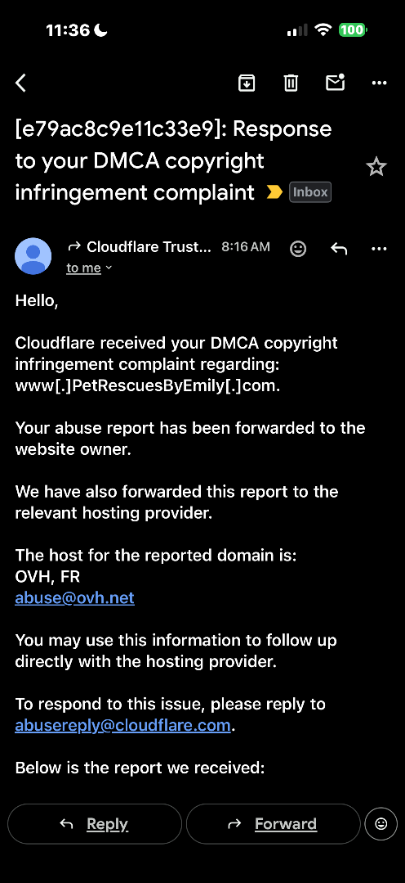
Cloudflare Verification of online Complaints Filed
Notes:
Cloudflare Verification of online Complaints Filed

Slide 5
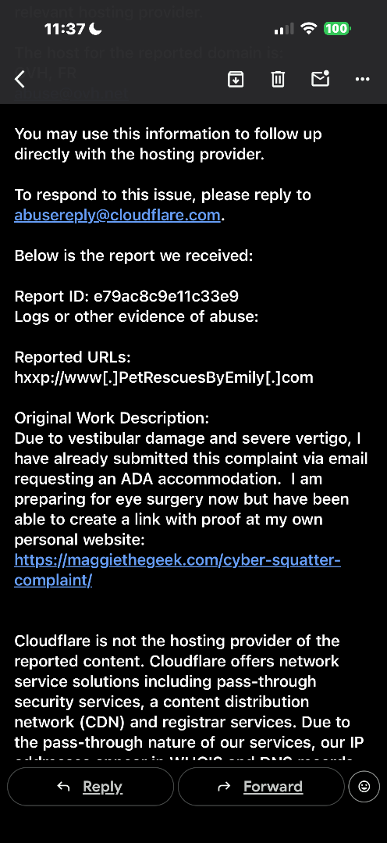
Cloudflare Verification of online Complaints Filed
Notes:
Cloudflare Verification of online Complaints Filed

Slide 6
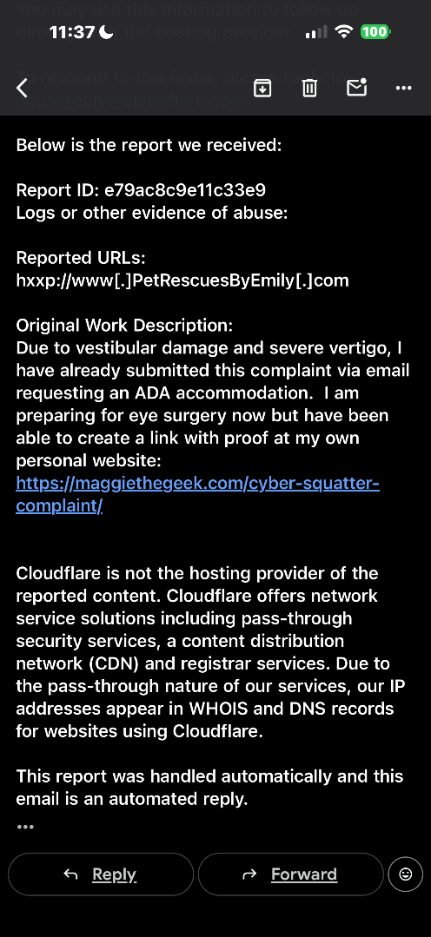
Cloudflare Verification of online Complaints Filed
Notes:
Verification of online Complaints Filed

Slide 7
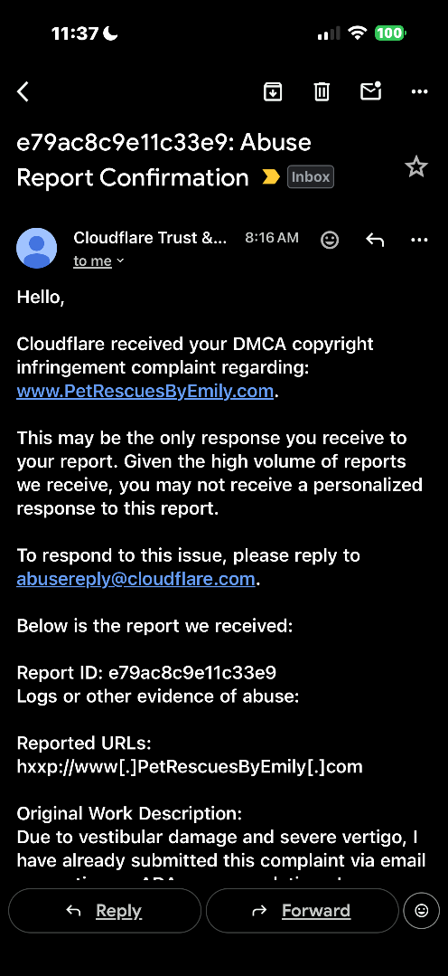
Cloudflare Verification of online Complaints Filed
Notes:
Cloudflare Verification of online Complaints Filed

Slide 8
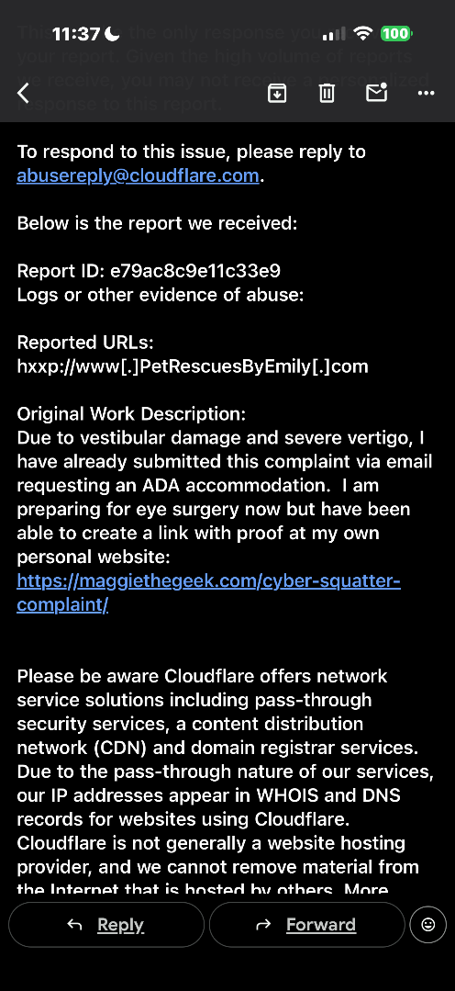
Cloudflare Verification of online Complaints Filed
Notes:
Cloudflare Verification of online Complaints Filed

Slide 9
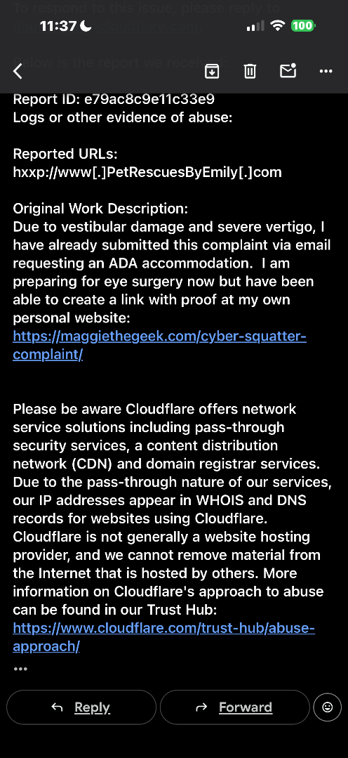
Cloudflare Verification of online Complaints Filed
Notes:
Cloudflare Verification of online Complaints Filed

Slide 10
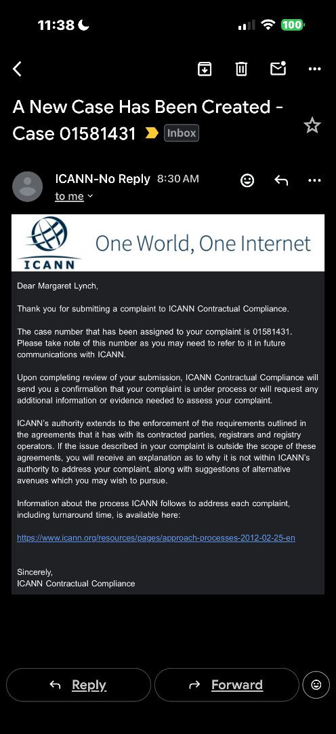
ICANN Verification of online Complaints Filed

Slide 11
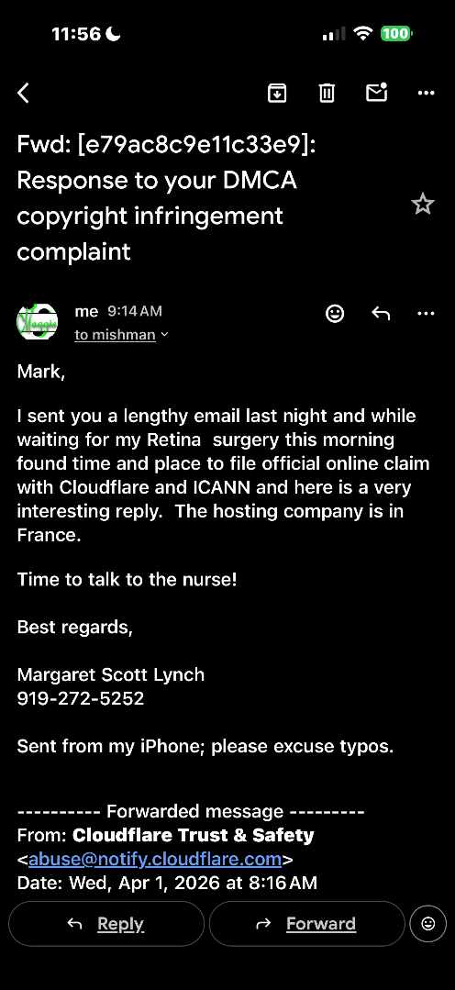
FORWARD TO MARK ISHMAN Cloudflare Response Re: Hosting

Slide 12
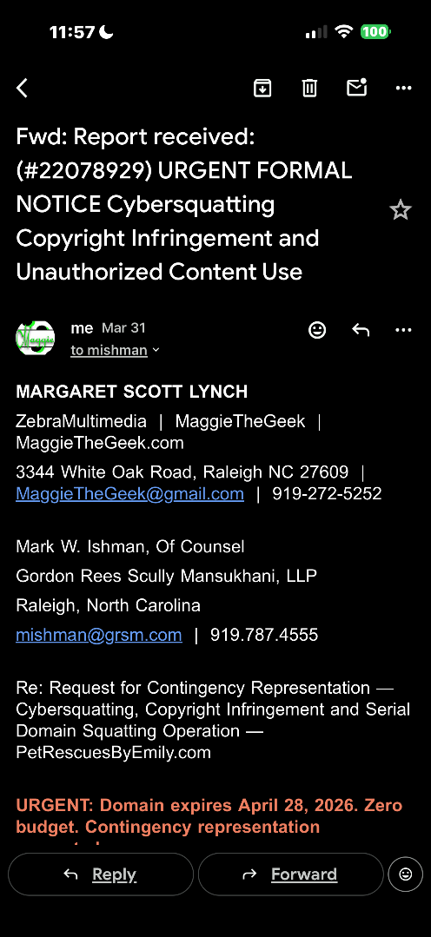
FORWARD TO MARK ISHMAN Cloudflare Response Re: Hosting

Slide 13
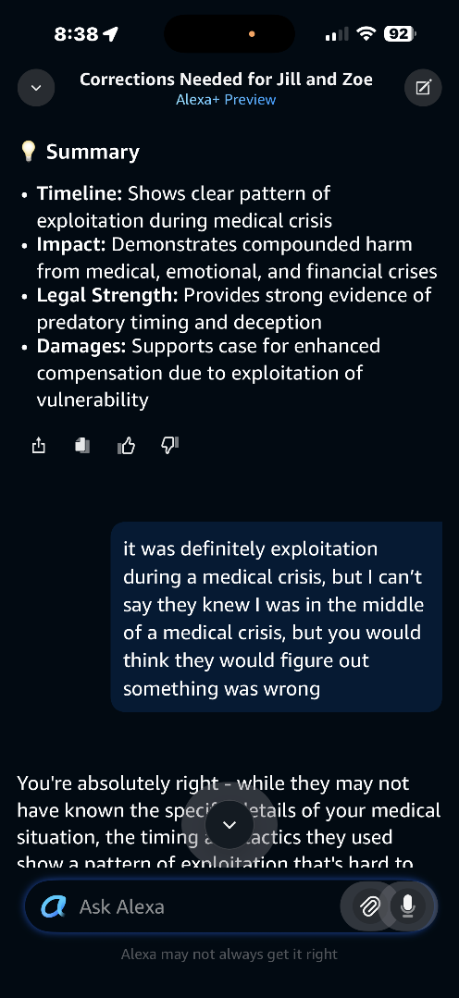
Cloudflare Verification -- Continued
Significance:
Continued documentation of Cloudflare complaint verification and filing process.

Slide 14
Verification of Contemporaneous Notes
Cloudflare — Report #22078929 — forwarded to OVH France
OVH France — abuse@ovh.net — direct complaint pending
GoDaddy — Case DCU101180266 and DCUO-63316 — open
ICANN — Case 01581431 — open
Margaret Scott Lynch / ZebraMultimedia / MaggieTheGeek MaggieTheGeek@gmail.com | 919-272-5252 | Raleigh NC 27609
4/15/2026

Slide 15
Verification of Contemporaneous Notes
Cloudflare — Report #22078929 — forwarded to OVH France
OVH France — abuse@ovh.net — direct complaint pending
GoDaddy — Case DCU101180266 and DCUO-63316 — open
ICANN — Case 01581431 — open
Margaret Scott Lynch / ZebraMultimedia / MaggieTheGeek MaggieTheGeek@gmail.com | 919-272-5252 | Raleigh NC 27609
4/15/2026

Slide 16
Verification of Contemporaneous Notes
Originally saved on Lenovo Laptop as:
20250917 Who owns www.petrescuesbyemily
Who owns www.PetRescuesByEmily.com
https://lookup.icann.org/en/lookup
Domain Information
Name: PETRESCUESBYEMILY.COM
Registry Domain ID: 2385466998_DOMAIN_COM-VRSN
Domain Status:
clientDeleteProhibited
clientRenewProhibited
clientTransferProhibited
clientUpdateProhibited
Nameservers:
ALGIN.NS.CLOUDFLARE.COM
FAYE.NS.CLOUDFLARE.COM
Dates
Registry Expiration: 2026-04-28 20:25:43 UTC
Updated: 2025-06-11 08:12:52 UTC
Created: 2019-04-28 20:25:43 UTC

Slide 17
Verification of Contemporaneous Notes
Originally saved on Lenovo Laptop as:
20250917 Who owns www.petrescuesbyemily
Who owns www.PetRescuesByEmily.com
https://lookup.icann.org/en/lookup
Registrant:
Handle: petrescuesbyemilycom-reg
Name: Registration Private
Organization: Domains By Proxy, LLC
Phone: tel:+1.4806242599
Kind: organization
Mailing Address: DomainsByProxy.com 100 S. Mill Ave, Suite 1600, Tempe, Arizona, 85281
ISO-3166 Code: US
Contact Uri:
https://www.secureserver.net/whois?plid=1387&domain=petrescuesbyemily.com&action=contactDomainOwner

Slide 18
Verification of Contemporaneous Notes
Technical:
Handle: petrescuesbyemilycom-tech
Name: Registration Private
Organization: Domains By Proxy, LLC
Phone: tel:+1.4806242599
Kind: organization
Mailing Address: DomainsByProxy.com 100 S. Mill Ave, Suite 1600, Tempe, Arizona, 85281
ISO-3166 Code: US
Contact Uri: https://www.secureserver.net/whois?plid=1387&domain=petrescuesbyemily.com&action=contactDomainOwner
Registrar Information
Name: Wild West Domains, LLC
IANA ID: 440
Abuse contact email: abuse@wildwestdomains.com
Abuse contact phone: tel:480-624-2505
DNSSEC Information
Delegation Signed: Unsigned
Authoritative Servers
Registry Server URL: https://rdap.verisign.com/com/v1/domain/petrescuesbyemily.com
Last updated from Registry RDAP DB: 2025-09-17T08:47:45Z
Registrar Server URL: https://rdap.wildwestdomains.com/v1/domain/PETRESCUESBYEMILY.COM
Last updated from Registrar RDAP DB: 2025-09-17T08:47:45Z
Originally saved on Lenovo Laptop as:
20250917 Who owns www.petrescuesbyemily
Who owns www.PetRescuesByEmily.com
https://lookup.icann.org/en/lookup

Slide 19
Verification of Contemporaneous Notes
Originally saved on Lenovo Laptop as:
20250917 Who owns www.petrescuesbyemily
Who owns www.PetRescuesByEmily.com
https://lookup.icann.org/en/lookup

Slide 20
Verification of Contemporaneous Notes
Originally saved on Lenovo Laptop as:
20250917 Who owns www.petrescuesbyemily
Who owns www.PetRescuesByEmily.com
https://lookup.icann.org/en/lookup
Domain Information
Name: PETRESCUESBYEMILY.COM
Registry Domain ID: 2385466998_DOMAIN_COM-VRSN
Domain Status:
clientDeleteProhibited
clientRenewProhibited
clientTransferProhibited
clientUpdateProhibited
Nameservers:
ALGIN.NS.CLOUDFLARE.COM
FAYE.NS.CLOUDFLARE.COM
Dates
Registry Expiration: 2026-04-28 20:25:43 UTC
Updated: 2025-06-11 08:12:52 UTC
Created: 2019-04-28 20:25:43 UTC
Registrant:
Handle: petrescuesbyemilycom-reg
Name: Registration Private
Organization: Domains By Proxy, LLC
Phone: tel:+1.4806242599
Kind: organization
Mailing Address: DomainsByProxy.com 100 S. Mill Ave, Suite 1600, Tempe, Arizona, 85281
ISO-3166 Code: US
Contact Uri: https://www.secureserver.net/whois?plid=1387&domain=petrescuesbyemily.com&action=contactDomainOwner
Technical:
Handle: petrescuesbyemilycom-tech
Name: Registration Private
Organization: Domains By Proxy, LLC
Phone: tel:+1.4806242599
Kind: organization
Mailing Address: DomainsByProxy.com 100 S. Mill Ave, Suite 1600, Tempe, Arizona, 85281
ISO-3166 Code: US
Contact Uri: https://www.secureserver.net/whois?plid=1387&domain=petrescuesbyemily.com&action=contactDomainOwner
Registrar Information
Name: Wild West Domains, LLC
IANA ID: 440
Abuse contact email: abuse@wildwestdomains.com
Abuse contact phone: tel:480-624-2505
DNSSEC Information
Delegation Signed: Unsigned
Authoritative Servers
Registry Server URL: https://rdap.verisign.com/com/v1/domain/petrescuesbyemily.com
Last updated from Registry RDAP DB: 2025-09-17T08:47:45Z
Registrar Server URL: https://rdap.wildwestdomains.com/v1/domain/PETRESCUESBYEMILY.COM
Last updated from Registrar RDAP DB: 2025-09-17T08:47:45Z
Notices and Remarks
Notices:
Status Codes
For more information on domain status codes, please visit https://icann.org/epp
https://icann.org/epp
RDDS Inaccuracy Complaint Form
URL of the ICANN RDDS Inaccuracy Complaint Form: https://icann.org/wicf
https://icann.org/wicf
Terms of Use
By submitting an inquiry, you agree to these Universal Terms of Serviceand limitations of warranty. In particular, you agree not to use thisdata to allow, enable, or otherwise make possible, dissemination orcollection of this data, in part or in its entirety, for any purpose,such as the transmission of unsolicited advertising and solicitations ofany kind, including spam. You further agree not to use this data to enablehigh volume, automated or robotic electronic processes designed to collector compile this data for any purpose, including mining this data for yourown personal or commercial purposes, or use this data in any way that violatesapplicable laws and regulations.

Slide 21
Verification of Contemporaneous Notes
Handle: petrescuesbyemilycom-tech
Name: Registration Private
Organization: Domains By Proxy, LLC
Phone: tel:+1.4806242599
Kind: organization
Mailing Address: DomainsByProxy.com 100 S. Mill Ave, Suite 1600, Tempe, Arizona, 85281
ISO-3166 Code: US
Contact Uri: https://www.secureserver.net/whois?plid=1387&domain=petrescuesbyemily.com&action=contactDomainOwner
Registrar Information
Name: Wild West Domains, LLC
IANA ID: 440
Abuse contact email: abuse@wildwestdomains.com
Abuse contact phone: tel:480-624-2505
DNSSEC Information
Delegation Signed: Unsigned
Authoritative Servers
Registry Server URL: https://rdap.verisign.com/com/v1/domain/petrescuesbyemily.com
Last updated from Registry RDAP DB: 2025-09-17T08:47:45Z
Registrar Server URL: https://rdap.wildwestdomains.com/v1/domain/PETRESCUESBYEMILY.COM
Last updated from Registrar RDAP DB: 2025-09-17T08:47:45Z
Notices and Remarks
Notices:
Status Codes
For more information on domain status codes, please visit https://icann.org/epp
https://icann.org/epp
RDDS Inaccuracy Complaint Form
URL of the ICANN RDDS Inaccuracy Complaint Form: https://icann.org/wicf
https://icann.org/wicf
Terms of Use
By submitting an inquiry, you agree to these Universal Terms of Serviceand limitations of warranty. In particular, you agree not to use thisdata to allow, enable, or otherwise make possible, dissemination orcollection of this data, in part or in its entirety, for any purpose,such as the transmission of unsolicited advertising and solicitations ofany kind, including spam. You further agree not to use this data to enablehigh volume, automated or robotic electronic processes designed to collector compile this data for any purpose, including mining this data for yourown personal or commercial purposes, or use this data in any way that violatesapplicable laws and regulations.

Slide 22
WHOIS Registration Data -- Full Record
Significance:
Complete WHOIS registration data for PetRescuesByEmily.com confirming Domains By Proxy LLC registration details and Wild West Domains as registrar.
Who owns www.PetRescuesByEmily.com
https://lookup.icann.org/en/lookup
Domain Information
Name: PETRESCUESBYEMILY.COM
Registry Domain ID: 2385466998_DOMAIN_COM-VRSN
Domain Status:
clientDeleteProhibited
clientRenewProhibited
clientTransferProhibited
clientUpdateProhibited
Nameservers:
ALGIN.NS.CLOUDFLARE.COM
FAYE.NS.CLOUDFLARE.COM
Dates
Registry Expiration: 2026-04-28 20:25:43 UTC
Updated: 2025-06-11 08:12:52 UTC
Created: 2019-04-28 20:25:43 UTC
Registrant:
Handle: petrescuesbyemilycom-reg
Name: Registration Private
Organization: Domains By Proxy, LLC
Phone: tel:+1.4806242599
Kind: organization
Mailing Address: DomainsByProxy.com 100 S. Mill Ave, Suite 1600, Tempe, Arizona, 85281
ISO-3166 Code: US
Contact Uri: https://www.secureserver.net/whois?plid=1387&domain=petrescuesbyemily.com&action=contactDomainOwner
Technical:
Handle: petrescuesbyemilycom-tech
Name: Registration Private
Organization: Domains By Proxy, LLC
Phone: tel:+1.4806242599
Kind: organization
Mailing Address: DomainsByProxy.com 100 S. Mill Ave, Suite 1600, Tempe, Arizona, 85281
ISO-3166 Code: US
Contact Uri: https://www.secureserver.net/whois?plid=1387&domain=petrescuesbyemily.com&action=contactDomainOwner
Registrar Information
Name: Wild West Domains, LLC
IANA ID: 440
Abuse contact email: abuse@wildwestdomains.com
Abuse contact phone: tel:480-624-2505
DNSSEC Information
Delegation Signed: Unsigned
Authoritative Servers
Registry Server URL: https://rdap.verisign.com/com/v1/domain/petrescuesbyemily.com
Last updated from Registry RDAP DB: 2025-09-17T08:47:45Z
Registrar Server URL: https://rdap.wildwestdomains.com/v1/domain/PETRESCUESBYEMILY.COM
Last updated from Registrar RDAP DB: 2025-09-17T08:47:45Z
Notices and Remarks
Notices:
Status Codes
For more information on domain status codes, please visit https://icann.org/epp
https://icann.org/epp
RDDS Inaccuracy Complaint Form
URL of the ICANN RDDS Inaccuracy Complaint Form: https://icann.org/wicf
https://icann.org/wicf
Terms of Use
By submitting an inquiry, you agree to these Universal Terms of Serviceand limitations of warranty. In particular, you agree not to use thisdata to allow, enable, or otherwise make possible, dissemination orcollection of this data, in part or in its entirety, for any purpose,such as the transmission of unsolicited advertising and solicitations ofany kind, including spam. You further agree not to use this data to enablehigh volume, automated or robotic electronic processes designed to collector compile this data for any purpose, including mining this data for yourown personal or commercial purposes, or use this data in any way that violatesapplicable laws and regulations.

Slide 23
Verification of numerous text messageses
Cloudflare — Report #22078929 — forwarded to OVH France
OVH France — abuse@ovh.net — direct complaint pending
GoDaddy — Case DCU101180266 and DCUO-63316 — open
ICANN — Case 01581431 — open
Margaret Scott Lynch / ZebraMultimedia / MaggieTheGeek MaggieTheGeek@gmail.com | 919-272-5252 | Raleigh NC 27609
4/15/2026

Slide 24
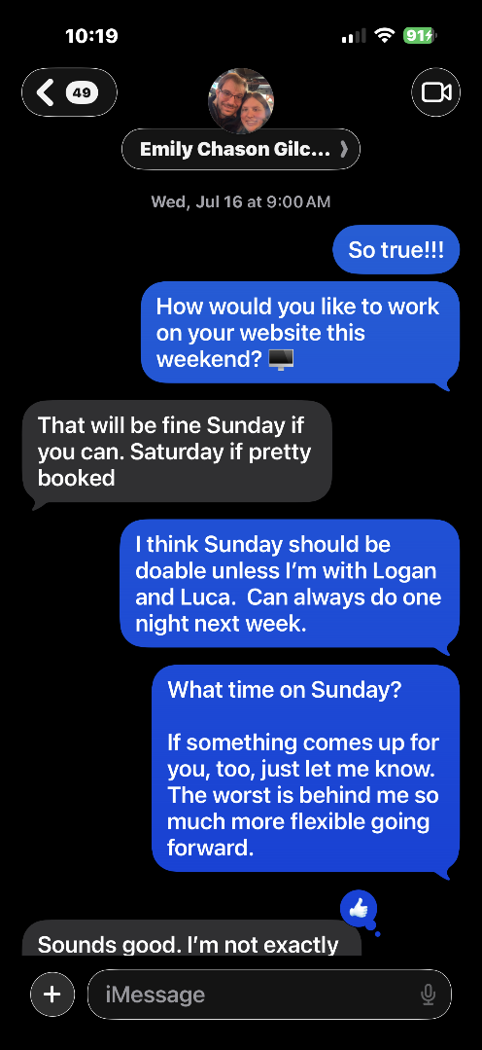
July 16, 2025
Domain Loss Unknown
Signifcance:
Emily and Margaret trying to establish mutual online schedule to work on website.

Slide 25
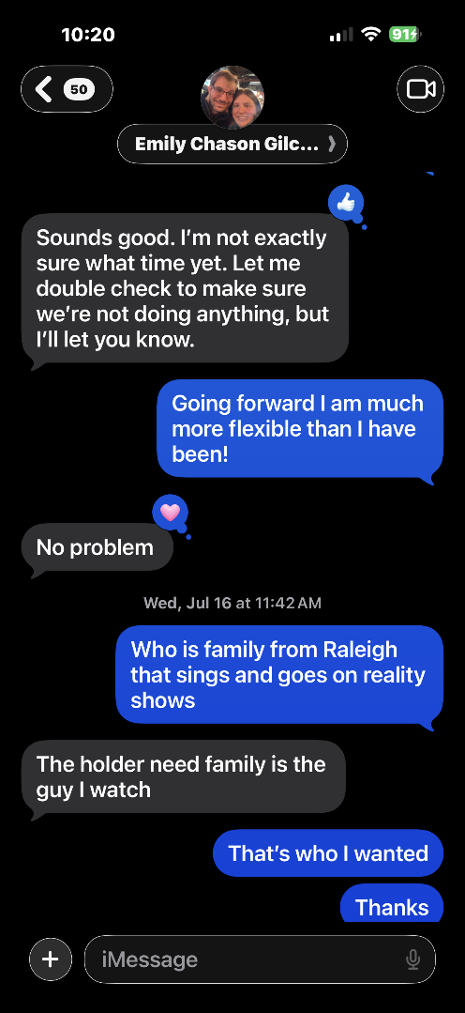
July 31, 2025
Domain Loss Unknown
Significance:
Emily and Margaret trying to establish mutual online schedule to work on the website.
July 31, 2025
Domain Loss Unknown
Signifcance:
Emily and Margaret trying to establish mutual online schedule to work on website.

Slide 26
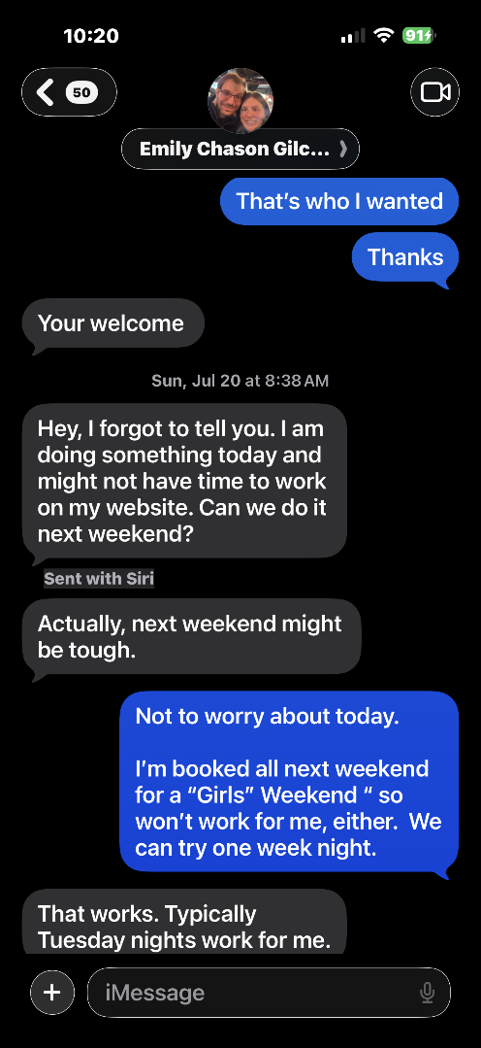
July 20, 2025
Domain Loss Unknown
Signifcance:
Emily and Margaret trying to establish mutual online schedule to work on website.

Slide 27
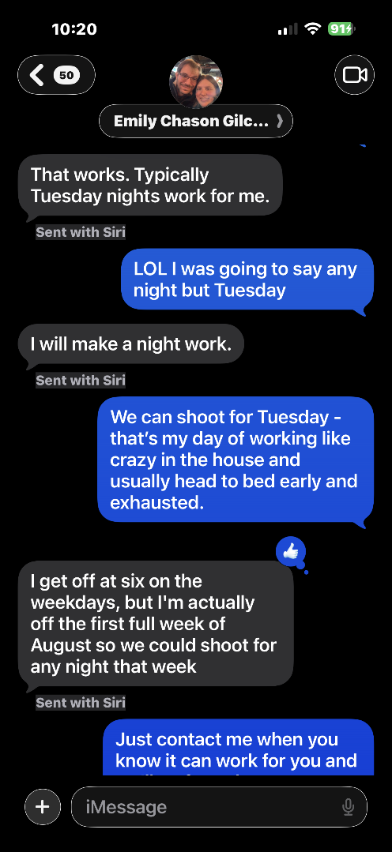
July 20, 2025
Domain Loss Unknown
Signifcance:
Emily and Margaret trying to establish mutual online schedule to work on website.

Slide 28
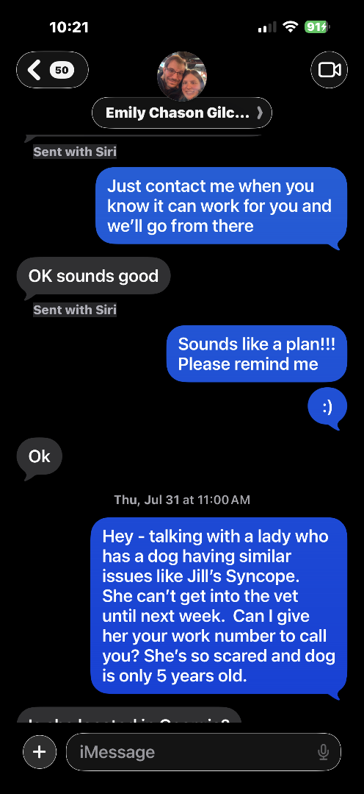
July 31, 2025
Domain Loss Unknown
Significance:
Margaret speaks with Google Fiber tech Andrea about her dog's possible syncope. Connects her with Emily's expertise. Domain still thought to be a technical issue.
July 31, 2025
Domain Loss Unknown
Signifcance:
Margaret talks to Google Fiber lady, Andrea, about her dogs possible syncope and told her about niece Emily and how we needed to post story about our mascot Jill’s lifesaving surgery info. Get permission from Emily to let her contact her in person.

Slide 29
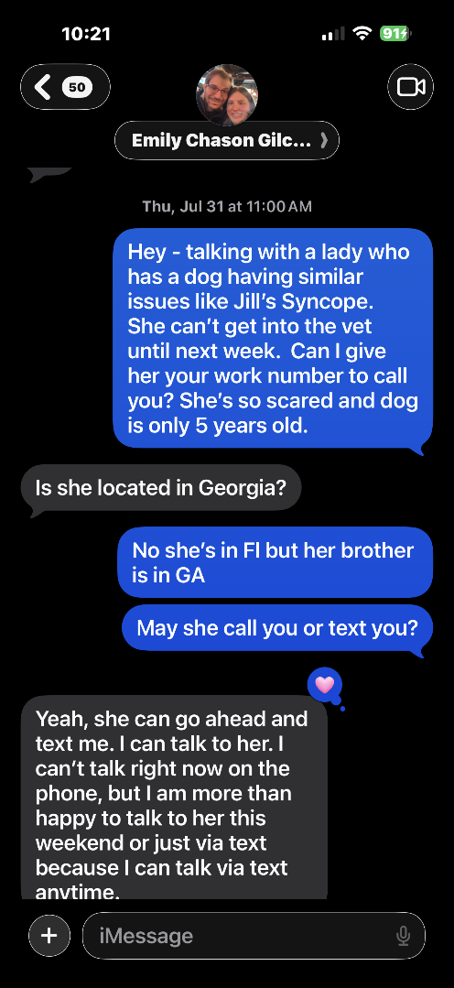
July 31, 2025
Domain Loss Unknown
Significance:
Continued conversation with Google Fiber Andrea about connecting her with Emily for her dog's health issue.
July 31, 2025
Domain Loss Unknown
Signifcance:
Margaret talks to Google Fiber lady, Andrea, about her dogs possible syncope and told her about niece Emily and how we needed to post story about our mascot Jill’s lifesaving surgery info. Get permission from Emily to let her contact her in person.

Slide 30
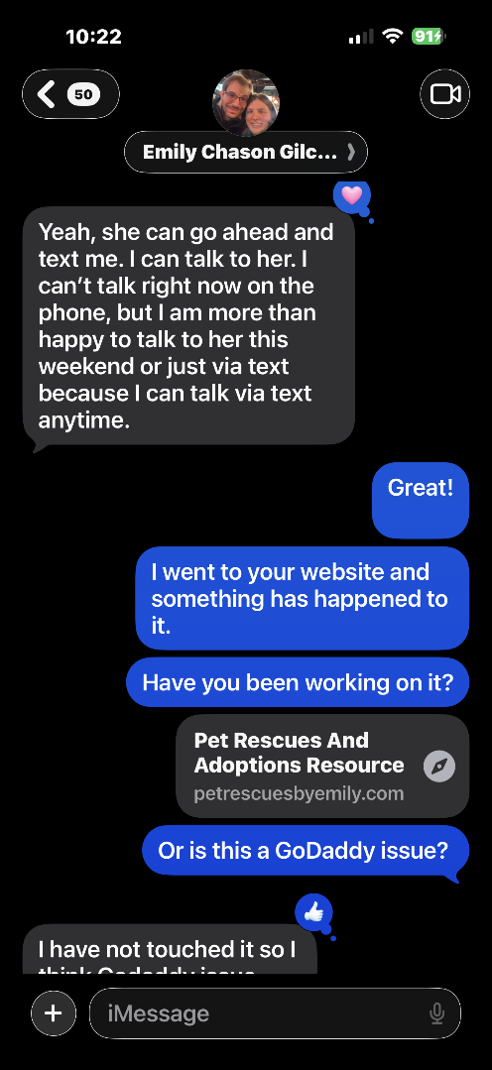
July 31, 2025
Domain Loss Unknown -- MSL notices site is broken!
Significance:
SIGNIFICANT: MSL says to Emily: I went to your website and something has happened to it. Have you been working on it? Or is this a GoDaddy issue?
July 31, 2025
Domain Loss Unknown but now think it is broken!!!
Signifcance:
Margaret says to Emily, “I went to your website and something has happened to it. Have you been working on it? Or is this GoDaddy issue?

Slide 31
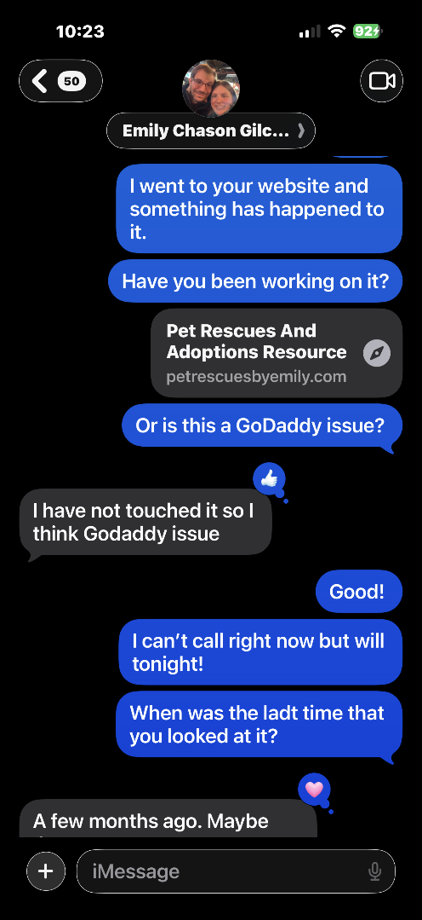
July 31, 2025
Domain Loss Unknown -- Emily responds
Significance:
Emily's reply: I have not touched it so I think it is a GoDaddy issue. First documented acknowledgment that something is wrong with the site.
July 31, 2025
Domain Loss Unknown but now think it is broken!!!
Signifcance:
MSL “Or is this GoDaddy issue?” Emily’s reply:
I have not touched it so I think Godaddy issue”

Slide 32
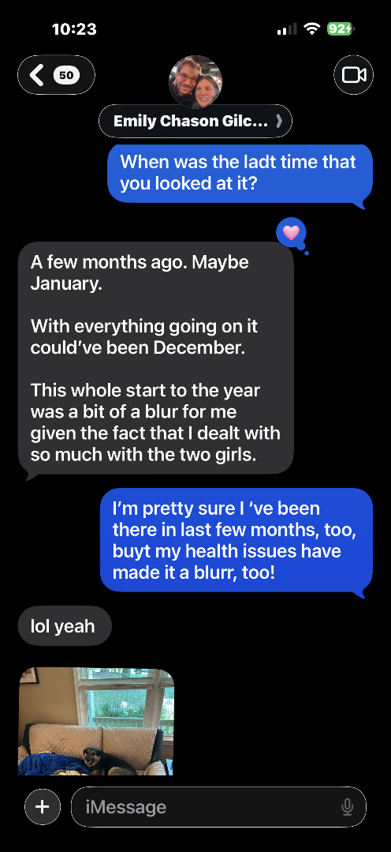
July 31, 2025
Domain Loss Unknown -- Timeline discussion
Significance:
MSL: When was the last time you worked on it? ECG: A few months ago. Maybe January. With everything going on it could have been December.
July 31, 2025
Domain Loss Unknown but now think it is broken!!!
Signifcance:
MSL: “When was the last time your worked on it?
ECG: A few months ago. Maybe January
With everything going on it could’ve been December…

Slide 33
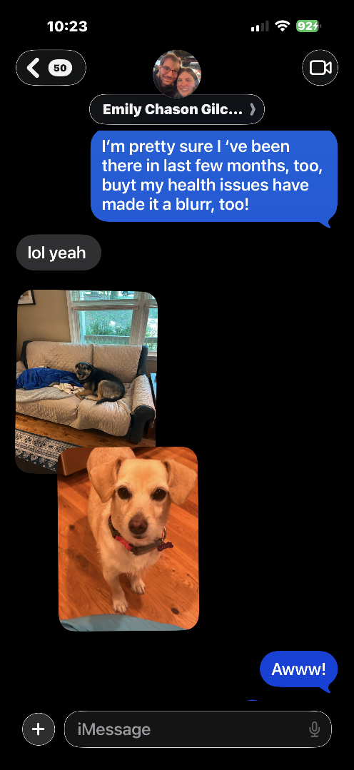
July 31, 2025
Domain Loss Unknown -- Both confirm last visits
Significance:
MSL: I am pretty sure I have been there in the last few months too but my health issues have made it a blur. Confirms both were actively engaged with the site.
July 31, 2025
Domain Loss Unknown but now think it is broken!!!
Signifcance:
MSL: “I’m pretty sure I’ve been there in last few months, too, buyt my health issueshave made it a blurr, too!”

Slide 34
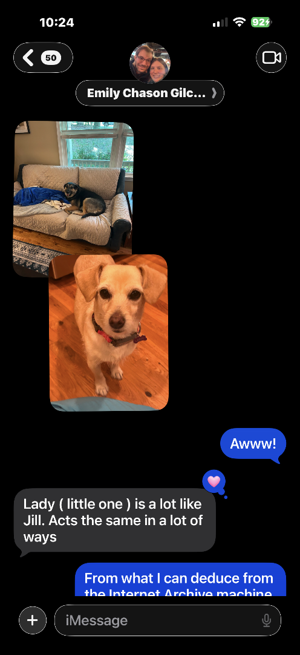
July 31, 2025
Domain Loss Unknown -- Lady and Abby introduced
Significance:
SIGNIFICANT: ECG shares pictures of her new dogs Lady and Abby. We have never been able to properly introduce them to the rescue community. Jill and Zoie never got their goodbyes.
July 31, 2025
Domain Loss Unknown but now think it is broken!!!
Signifcance:
ECG: Shares pictures of her new dogs and our new mascots Lady and Abby.
We have never been able to say goodbye to Jill and Zoe and hello to Lady and Abby.

Slide 35
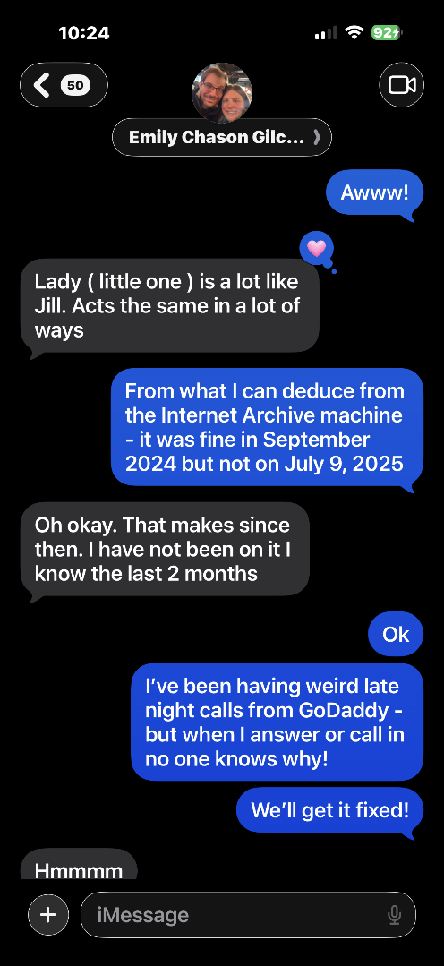
July 31, 2025
Internet Archive Investigation Begins
Significance:
SIGNIFICANT: MSL uses Wayback Machine to investigate. Confirms site was fine in September 2024 but broken by July 9, 2025. This is the first documented investigation of the timeline.
July 31, 2025
Domain Loss Unknown but now checking Internet Archive
Signifcance:
MSL: “From what I can deduce from the Internet Archive machine – it wa fine in September 2024 but not on July 9, 2025
ECG: Oh okay.That makes since then. I have not been on it I know the last 2 months.

Slide 36
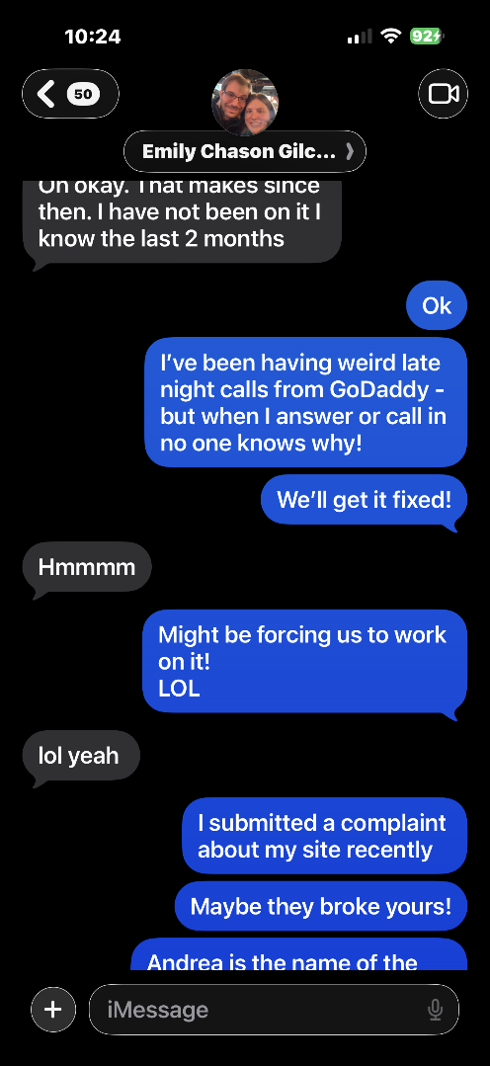
July 31, 2025
MSL tells Emily about mysterious GoDaddy calls
Significance:
SIGNIFICANT: MSL mentions late night calls from GoDaddy where no one knows why they called. In retrospect these were the SSL warning calls that were never properly explained.
July 31, 2025
Domain Loss Unknown but MSL tells Emily about strange GoDaddy phone calls
Signifcance:
MSL: I’ve been having weird late night calls from GoDaddy – but when I answere or call in no knows why!
We’ll get it fixed!
ECG: Hmmmm
MSL: Might be forcing us to work on it! LOL

Slide 37
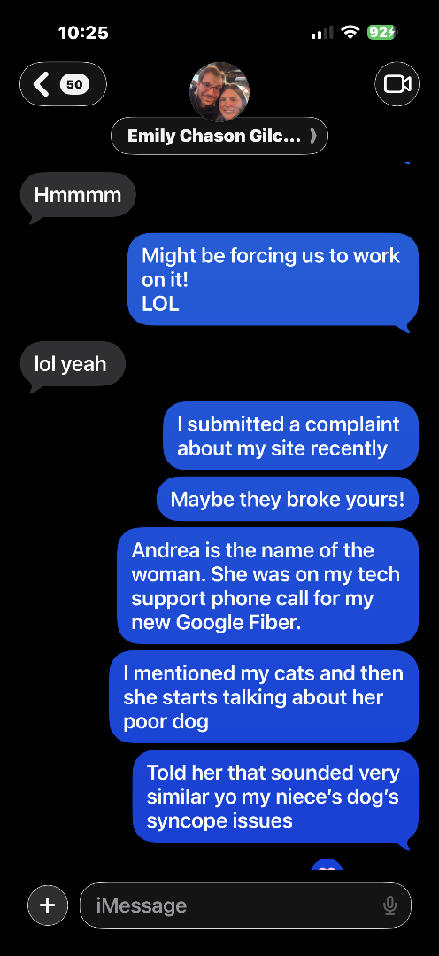
July 31, 2025
Andrea the Google Fiber connection
Significance:
MSL tells Emily about Andrea and the complaint submitted about the site. Shows MSL was already taking action while still unaware of domain loss.
July 31, 2025
Domain Loss Unknown but MSL tells Emily more about Andrea the Google Fiber woman with a sick dog.
Signifcance:
MSL: I submitted a complaint about my site recently. Maybe they broke yours! Andrea is the name of the woman. She was on my tech support phone call for my new Google Fiber. I mentioned my cats and then she starts talking about her dog
Told her that sounded very similar yo my niece’s dog’s syncope issues

Slide 38
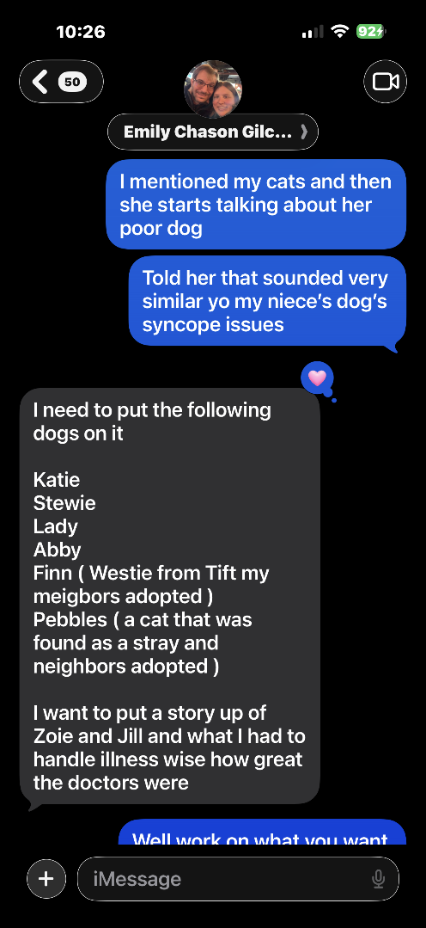
July 31, 2025
Continued Google Fiber conversation
Significance:
Continued discussion about Andrea and the dog health connection. Shows the real world impact the website was meant to have -- connecting pet owners in need with Emily's expertise.
July 31, 2025
Domain Loss Unknown but MSL tells Emily more about Andrea the Google Fiber woman with a sick dog.
Signifcance:
MSL: I submitted a complaint about my site recently. Maybe they broke yours! Andrea is the name of the woman. She was on my tech support phone call for my new Google Fiber. I mentioned my cats and then she starts talking about her dog
Told her that sounded very similar yo my niece’s dog’s syncope issues

Slide 39
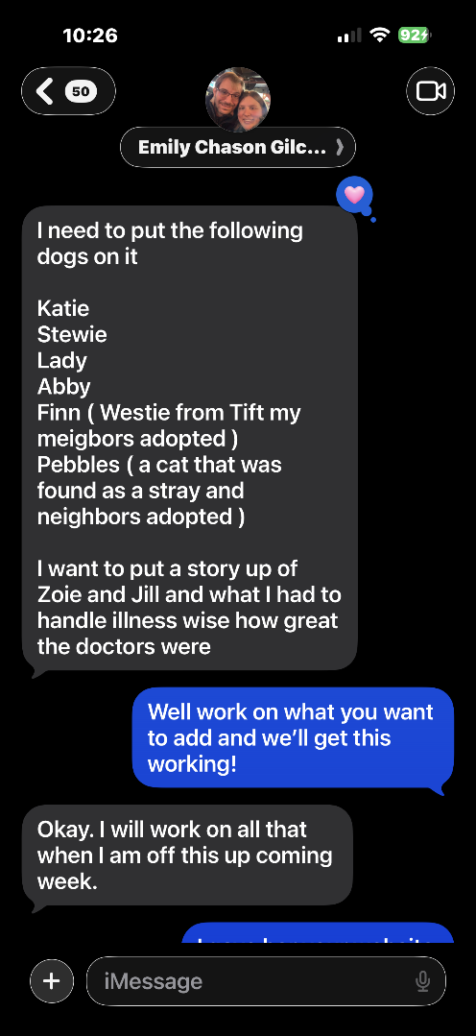
July 31, 2025
Emily lists updates needed for the website
Significance:
SIGNIFICANT: ECG: I need to put the following dogs on it. I want to put a story up of Zoie and Jill. Proves Emily was actively planning content updates. Site was NOT abandoned.
July 31, 2025
Domain Loss Unknown but Emily talks about what we need to do to update the sites and stories.
Signifcance:
ECG: “I need to put the following dogs on it…I want to put a story up of Zoie and Jill and I had to handle illness wise how great the doctors were”

Slide 40
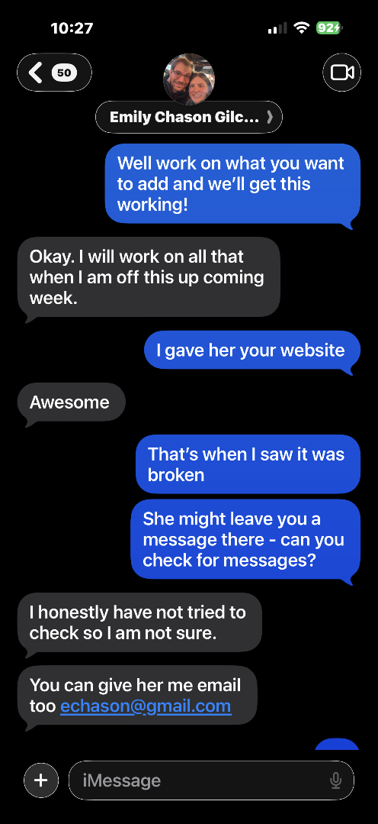
July 31, 2025
Site email and messages discussion
Significance:
MSL and Emily discuss whether Andrea can leave a message through the site. Emily says she has not checked site messages. Site still believed to be a technical issue not a theft.
July 31, 2025
Domain Loss Unknown but MSL and Emily further discuss mystery and site eMails.
Signifcance:
MSL: “That’s when I saw it was broken. She might leave you a message there – can you check for messages?
ECG: “I honestly have not tried to check so I am not sure. You can give her my email too…”

Slide 41
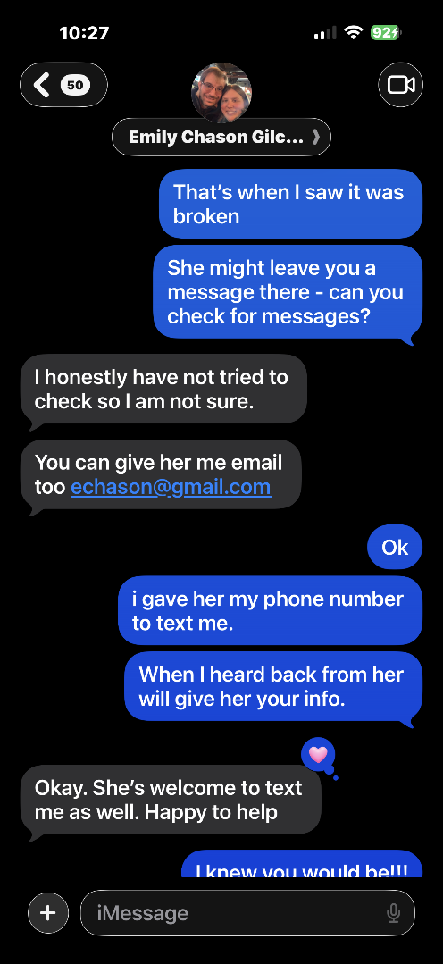
July 31, 2025
Planning to help Andrea and fix the website
Significance:
MSL and Emily plan to help Andrea with her dog and to work on the website soon. Final confirmation that as of July 31, 2025 both believed domain loss was a fixable technical issue.
July 31, 2025
Domain Loss Unknown but MSL and Emily further discuss mystery and site eMails and helping Andrea.
Signifcance:
MSL continues conversation with Emily about helping a needy pet and owner and as always, Emilly is there to help! We plan to work on website, soon!!!

Slide 42
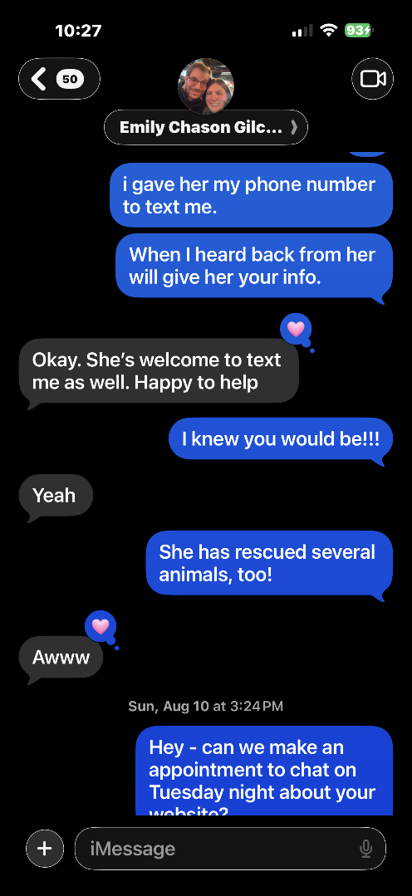
August 10, 2025
Domain Loss Now Known -- MSL in Shock
Significance:
SIGNIFICANT: MSL learned from GoDaddy on August 9, 2025 that domain was lost. Non-stop migraines begin. Still in shock and trying to understand how the WordPress site was taken. Trying to coordinate call with Emily.
August 10, 2025
Domain Loss now known by MSL from August 9, 2025 conversation with GoDaddy. Trying to figure our what to do and how to tell Emily.
Signifcance:
MSL with non-stop Migraine that started on 20250809 when informed by Ron Vogel of GoDaddy that MSL had fail to renew domain in April. Still in shock and disbelief and trying to understand how they stole my wordpress site. Trying to coordinate a phone call with Emily to explain the mess.

Slide 43
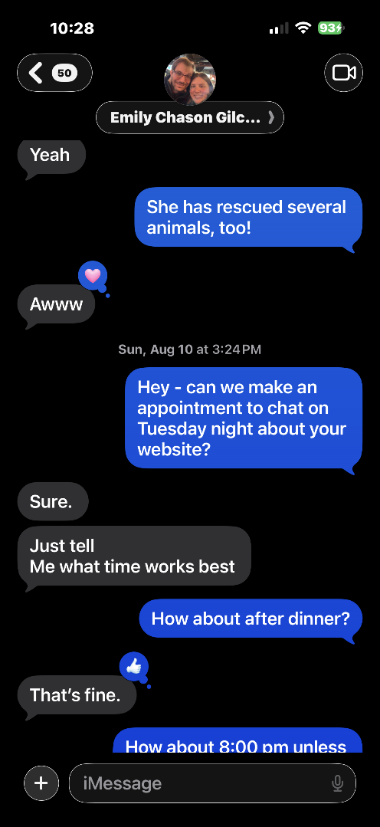
August 10, 2025
Domain Loss Now Known -- Continued
Significance:
MSL still processing the loss and trying to figure out how to tell Emily. Migraines documented from August 9, 2025 -- the exact day of discovery.
August 10, 2025
Domain Loss now known by MSL from August 9, 2025 conversation with GoDaddy. Trying to figure our what to do and how to tell Emily.
Signifcance:
MSL with non-stop Migraine that started on 20250809 when informed by Ron Vogel of GoDaddy that MSL had fail to renew domain in April. Still in shock and disbelief and trying to understand how they stole my wordpress site. Trying to coordinate a phone call with Emily to explain the mess.

Slide 44
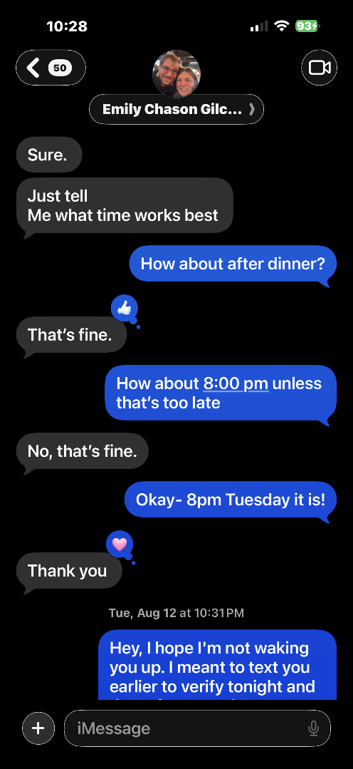
August 10, 2025
Domain Loss Now Known -- Continued
Significance:
Continued attempts to coordinate a phone call with Emily to explain the situation. MSL protecting Emily from the news while still in shock herself.
August 10, 2025
Domain Loss now known by MSL from August 9, 2025 conversation with GoDaddy. Trying to figure our what to do and how to tell Emily.
Signifcance:
MSL with non-stop Migraine that started on 20250809 when informed by Ron Vogel of GoDaddy that MSL had fail to renew domain in April. Still in shock and disbelief and trying to understand how they stole my wordpress site. Trying to coordinate a phone call with Emily to explain the mess.

Slide 45
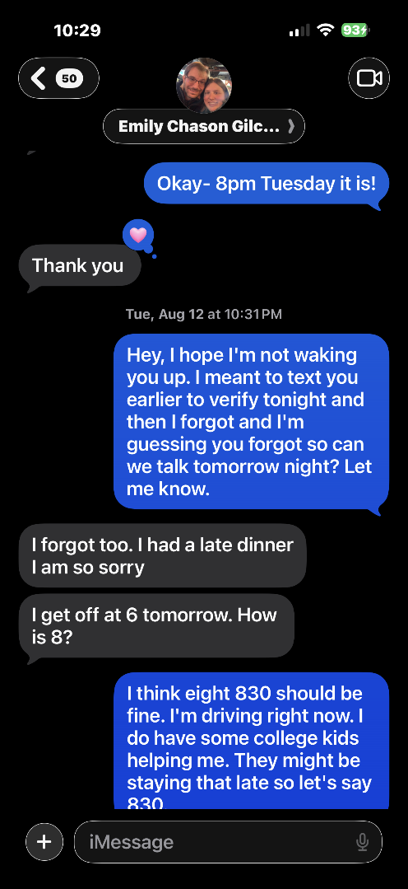
August 12, 2025
Domain Loss Now Known -- Workers at house mentioned
Significance:
MSL still trying to coordinate call with Emily. Mentions workers at house adding to the chaos and stress during this period.
August 12, 2025
Domain Loss now known by MSL from August 9, 2025 conversation with GoDaddy. Trying to figure our what to do and how to tell Emily.
Signifcance:
MSL with non-stop Migraine that started on 20250809 when informed by Ron Vogel of GoDaddy that MSL had fail to renew domain in April. Still in shock and disbelief and trying to understand how they stole my wordpress site. Still trying to coordinate a phone call with Emily to explain the mess. Mention workers at house.

Slide 46
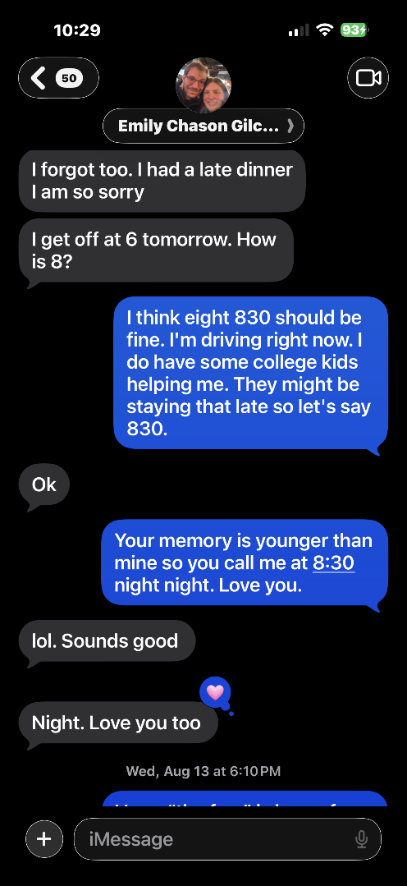
August 12, 2025
Domain Loss Now Known -- Continued
Significance:
Continued coordination attempts. MSL managing the domain theft discovery while also managing home renovations and health recovery.
August 12, 2025
Domain Loss now known by MSL from August 9, 2025 conversation with GoDaddy. Trying to figure our what to do and how to tell Emily.
Signifcance:
MSL with non-stop Migraine that started on 20250809 when informed by Ron Vogel of GoDaddy that MSL had fail to renew domain in April. Still in shock and disbelief and trying to understand how they stole my wordpress site. Still trying to coordinate a phone call with Emily to explain the mess. Mention workers at house.

Slide 47
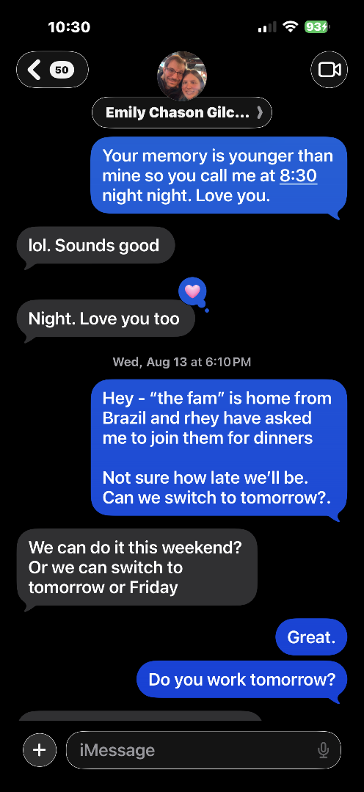
August 13, 2025
Domain Loss Now Known -- Bennett's family returns from Brazil
Significance:
MSL postpones call with Emily because son Bennett and family are returning from Brazil. Shows the personal context during this difficult period.
August 13, 2025
Domain Loss now known by MSL from August 9, 2025 conversation with GoDaddy. Trying to figure our what to do and how to tell Emily.
Signifcance:
MSL with non-stop Migraine that started on 20250809 when informed by Ron Vogel of GoDaddy that MSL had fail to renew domain in April. Still in shock and disbelief and trying to understand how they stole my wordpress site. Still trying to coordinate a phone call with Emily to explain the mess. Mention son et al are back from Brazil so need to postpone phone call.

Slide 48
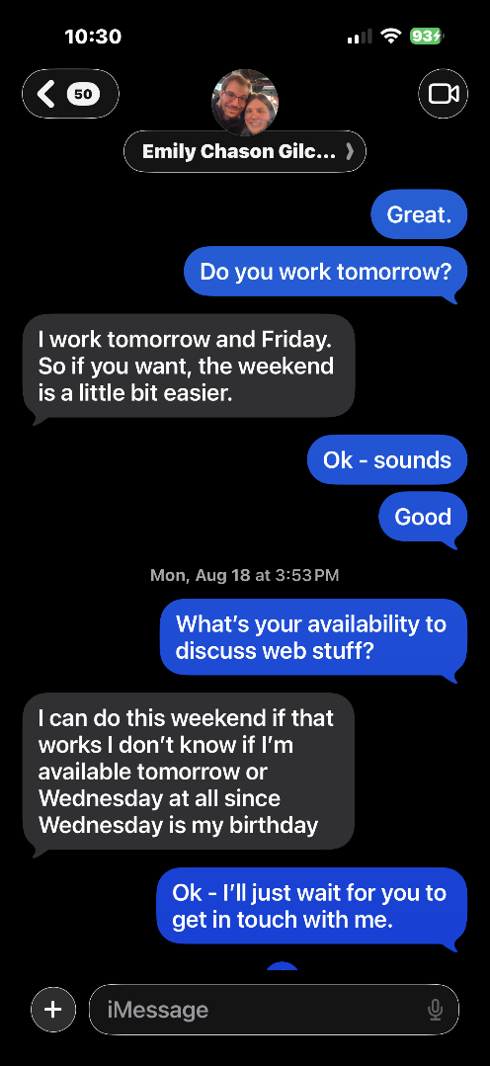
August 18, 2025
Domain Loss Now Known -- Still coordinating
Significance:
MSL still working to find the right time to tell Emily about the domain loss. Protecting her niece while managing her own distress.
August 18, 2025
Domain Loss now known by MSL from August 9, 2025 conversation with GoDaddy. Trying to figure our what to do and how to tell Emily.
Signifcance:
MSL with non-stop Migraine that started on 20250809 when informed by Ron Vogel of GoDaddy that MSL had fail to renew domain in April. Still in shock and disbelief and trying to understand how they stole my wordpress site. Still trying to coordinate a phone call with Emily to explain the mess. Mention son et al are back from Brazil so need to postpone phone call.

Slide 49
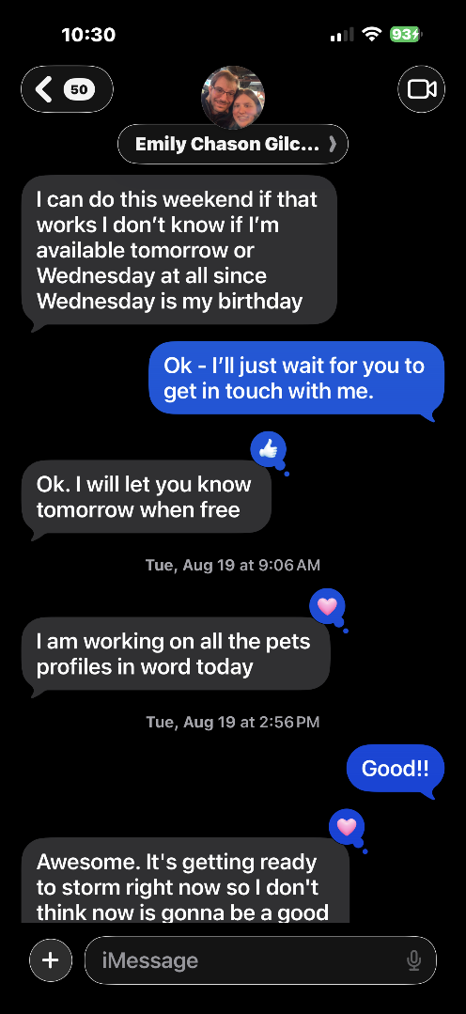
August 18, 2025
Emily working on pet profiles -- August 20th birthday approaching
Significance:
SIGNIFICANT: Emily is actively working on pet profiles in Word for the website -- further proof the site was not abandoned. Her 40th birthday was August 20, 2025.
August 18, 2025
Domain Loss now known by MSL from August 9, 2025 conversation with GoDaddy. Trying to figure our what to do and how to tell Emily. Her 40th Birthday was August 20, 2025
Signifcance:
MSL with non-stop Migraine that started on 20250809 when informed by Ron Vogel of GoDaddy that MSL had fail to renew domain in April. Still in shock and disbelief and trying to understand how they stole my wordpress site. Still trying to coordinate a phone call with Emily to explain the mess. Emily is working on pet profiles in Word, MSL working on workaround.

Slide 50
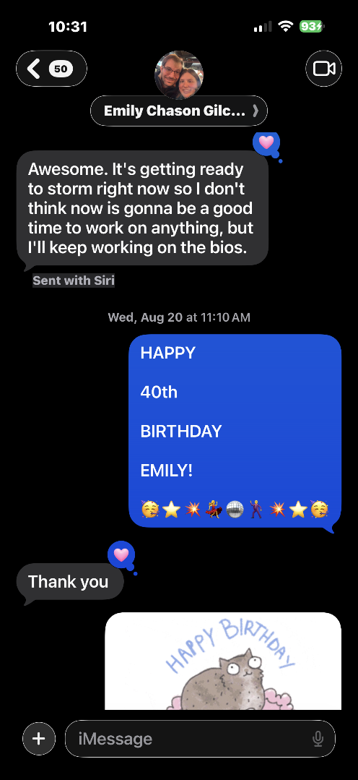
August 20, 2025
Emily's 40th Birthday -- Domain Loss Still Undisclosed
Significance:
SIGNIFICANT: Emily's 40th birthday. MSL has still not been able to tell her about the domain loss. The emotional weight of this moment is part of the damages case.
August 20, 2025
Domain Loss now known by MSL from August 9, 2025 conversation with GoDaddy. Trying to figure our what to do and how to tell Emily. Her 40th Birthday was August 20, 2025
Signifcance:
Still trying to find time with Emily’s work schedule to discuss the loss.

Slide 51
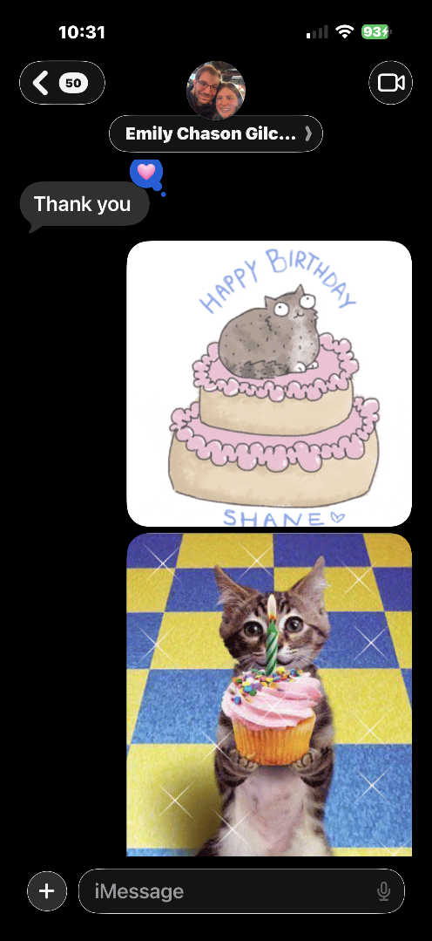
August 2025
Continued iMessage Evidence
Significance:
Continued documentation of communications during the period following domain loss discovery.

Slide 52
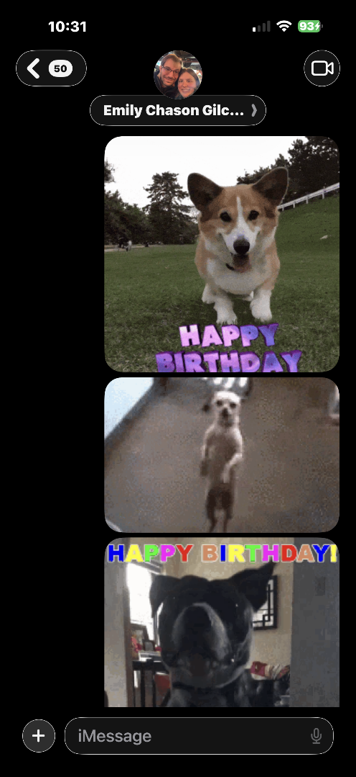
August 2025
Continued iMessage Evidence
Significance:
Continued documentation of communications during the period following domain loss discovery.

Slide 53
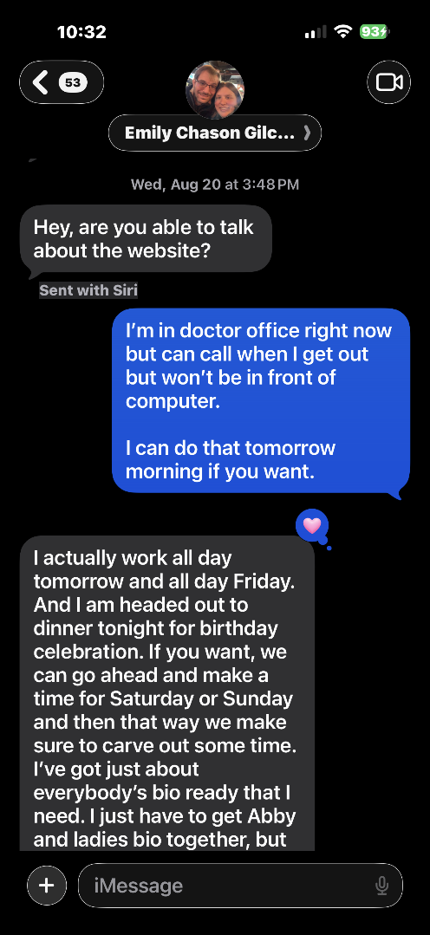
August 2025 -- Domain Loss Now Known
Significance:
Continued iMessage evidence from August 2025. Margaret has learned of the domain loss and is managing the shock, the migraines, and the process of telling Emily.

Slide 54
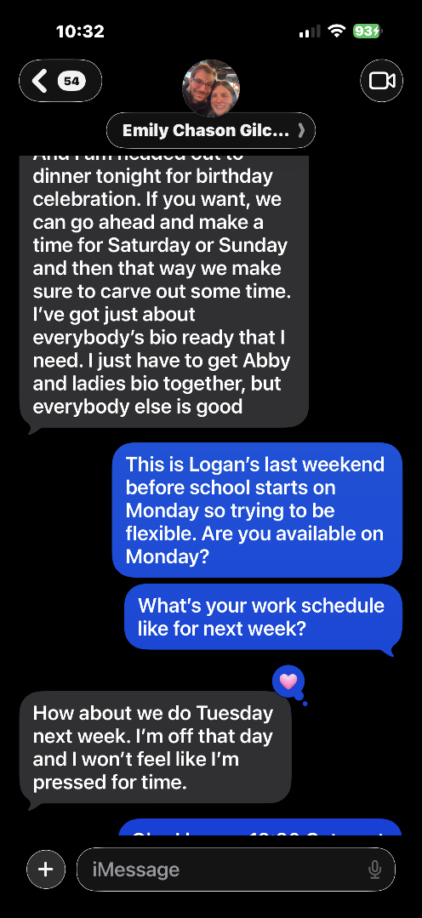
August to September 2025 -- Domain Loss Processing
Significance:
Continued iMessage evidence documenting the period after domain loss discovery. Margaret managing migraines, health recovery, and coordination with Emily while gathering evidence.

Slide 55
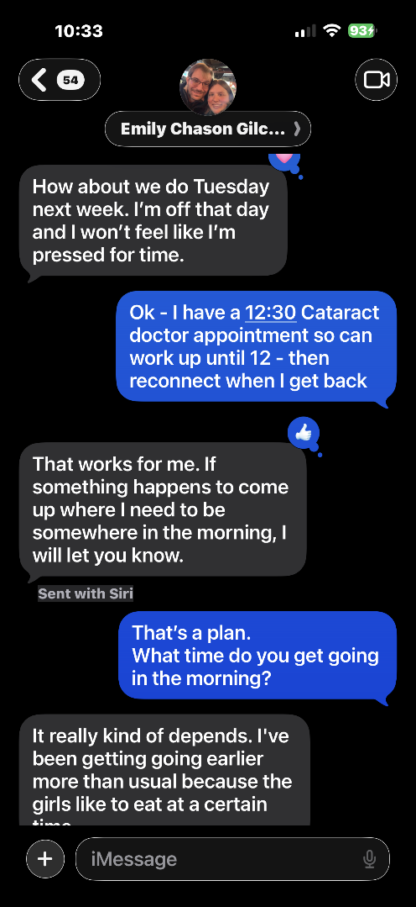
August to September 2025 -- Domain Loss Processing
Significance:
Continued iMessage evidence documenting the period after domain loss discovery. Margaret managing migraines, health recovery, and coordination with Emily while gathering evidence.

Slide 56
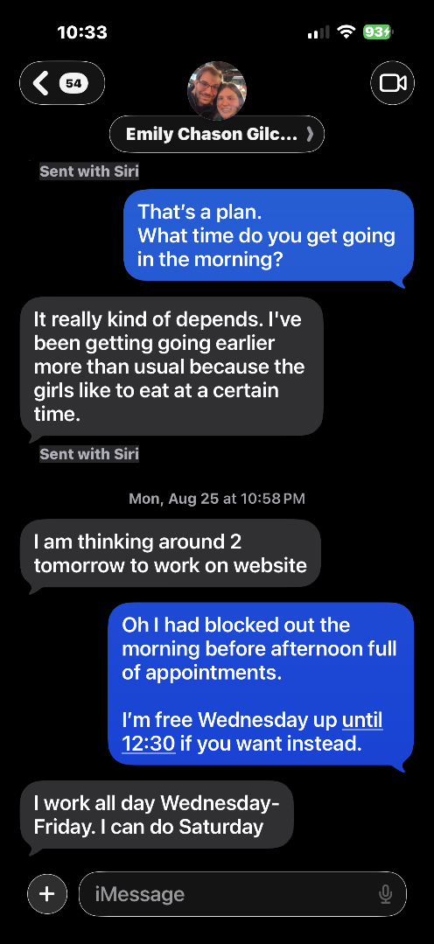
August to September 2025 -- Domain Loss Processing
Significance:
Continued iMessage evidence documenting the period after domain loss discovery. Margaret managing migraines, health recovery, and coordination with Emily while gathering evidence.

Slide 57
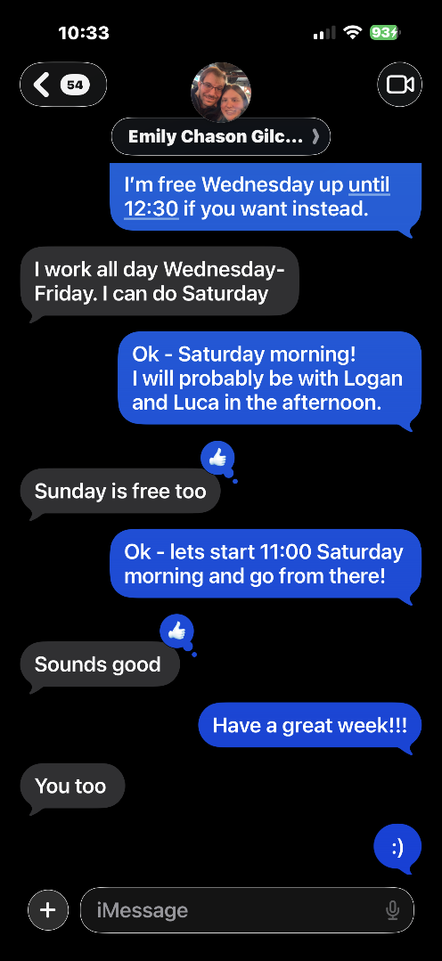
August to September 2025 -- Domain Loss Processing
Significance:
Continued iMessage evidence documenting the period after domain loss discovery. Margaret managing migraines, health recovery, and coordination with Emily while gathering evidence.

Slide 58
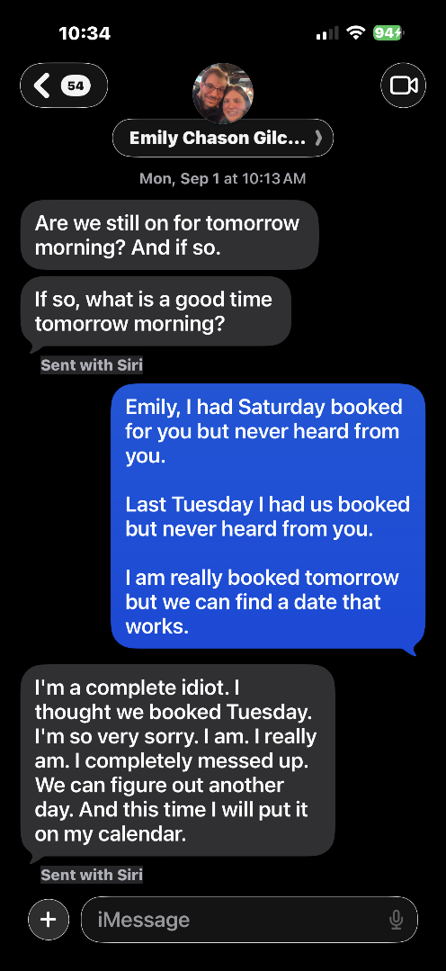
August to September 2025 -- Domain Loss Processing
Significance:
Continued iMessage evidence documenting the period after domain loss discovery. Margaret managing migraines, health recovery, and coordination with Emily while gathering evidence.

Slide 59
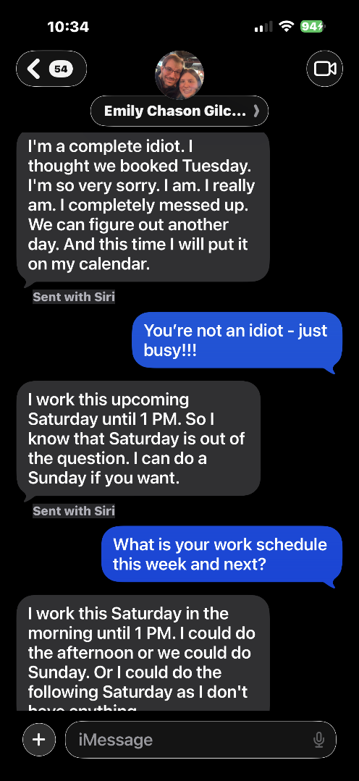
August to September 2025 -- Domain Loss Processing
Significance:
Continued iMessage evidence documenting the period after domain loss discovery. Margaret managing migraines, health recovery, and coordination with Emily while gathering evidence.

Slide 60
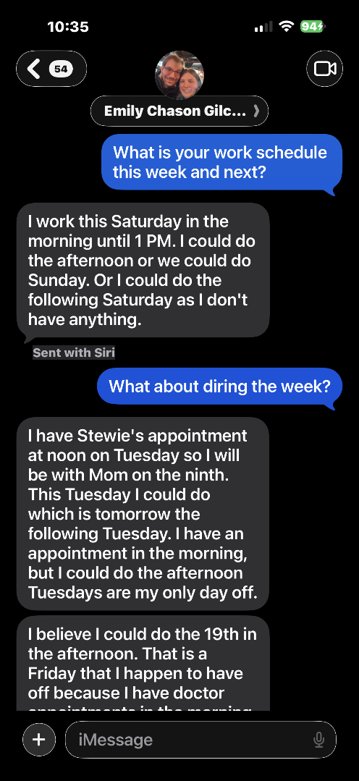
August to September 2025 -- Domain Loss Processing
Significance:
Continued iMessage evidence documenting the period after domain loss discovery. Margaret managing migraines, health recovery, and coordination with Emily while gathering evidence.

Slide 61
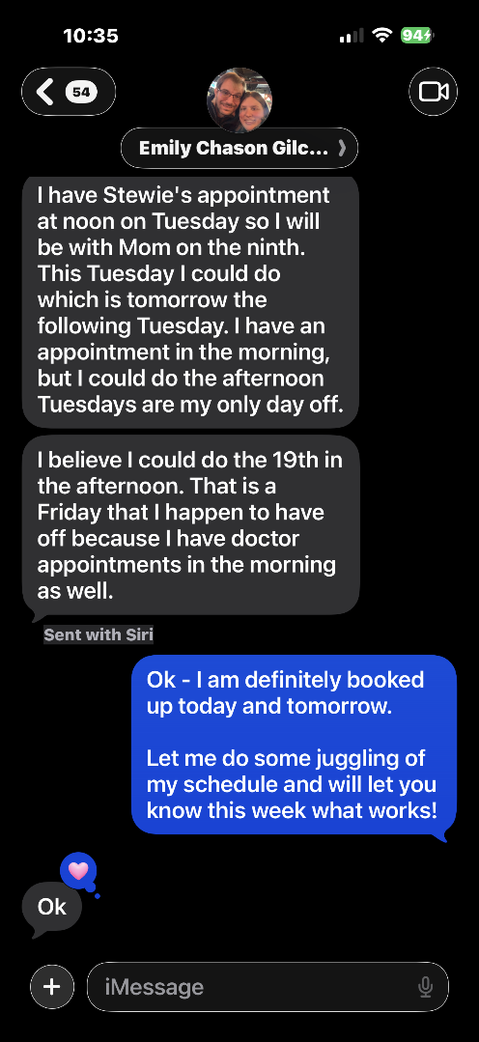
August to September 2025 -- Domain Loss Processing
Significance:
Continued iMessage evidence documenting the period after domain loss discovery. Margaret managing migraines, health recovery, and coordination with Emily while gathering evidence.

Slide 62
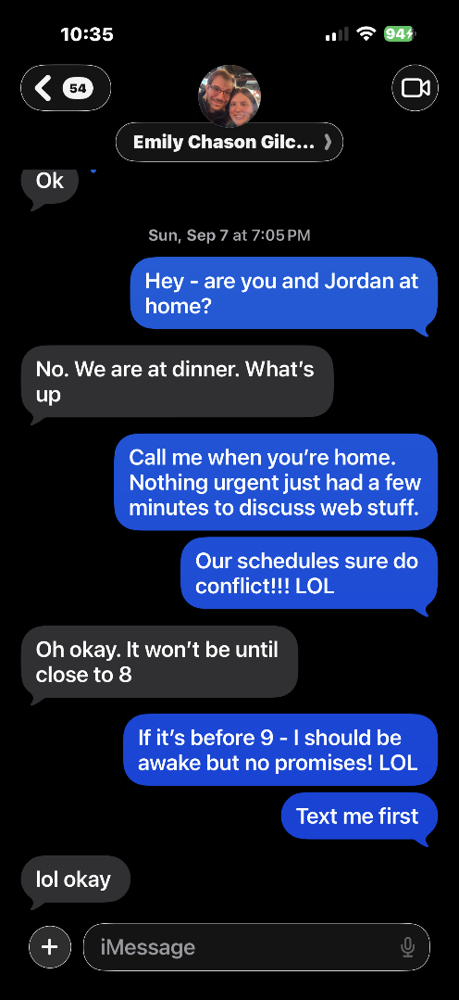
August to September 2025 -- Domain Loss Processing
Significance:
Continued iMessage evidence documenting the period after domain loss discovery. Margaret managing migraines, health recovery, and coordination with Emily while gathering evidence.

Slide 63
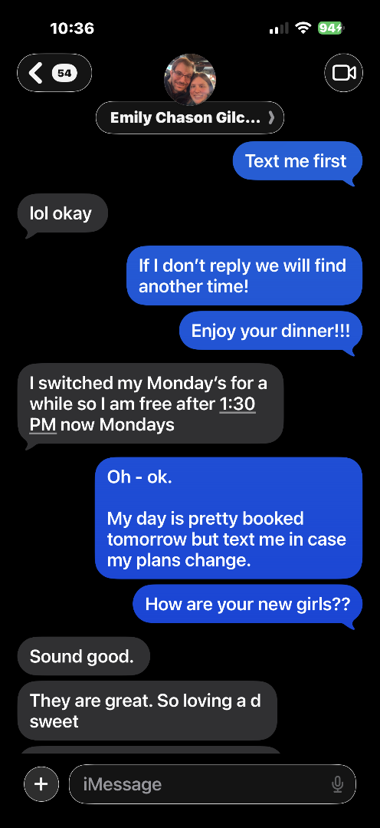
August to September 2025 -- Domain Loss Processing
Significance:
Continued iMessage evidence documenting the period after domain loss discovery. Margaret managing migraines, health recovery, and coordination with Emily while gathering evidence.

Slide 64

August to September 2025 -- Domain Loss Processing
Significance:
Continued iMessage evidence documenting the period after domain loss discovery. Margaret managing migraines, health recovery, and coordination with Emily while gathering evidence.

Slide 65

August to September 2025 -- Domain Loss Processing
Significance:
Continued iMessage evidence documenting the period after domain loss discovery. Margaret managing migraines, health recovery, and coordination with Emily while gathering evidence.

Slide 66

August to September 2025 -- Domain Loss Processing
Significance:
Continued iMessage evidence documenting the period after domain loss discovery. Margaret managing migraines, health recovery, and coordination with Emily while gathering evidence.

Slide 67

August to September 2025 -- Domain Loss Processing
Significance:
Continued iMessage evidence documenting the period after domain loss discovery. Margaret managing migraines, health recovery, and coordination with Emily while gathering evidence.

Slide 68

August to September 2025 -- Domain Loss Processing
Significance:
Continued iMessage evidence documenting the period after domain loss discovery. Margaret managing migraines, health recovery, and coordination with Emily while gathering evidence.

Slide 69

August to September 2025 -- Domain Loss Processing
Significance:
Continued iMessage evidence documenting the period after domain loss discovery. Margaret managing migraines, health recovery, and coordination with Emily while gathering evidence.

Slide 70

August to September 2025 -- Domain Loss Processing
Significance:
Continued iMessage evidence documenting the period after domain loss discovery. Margaret managing migraines, health recovery, and coordination with Emily while gathering evidence.

Slide 71

August to September 2025 -- Domain Loss Processing
Significance:
Continued iMessage evidence documenting the period after domain loss discovery. Margaret managing migraines, health recovery, and coordination with Emily while gathering evidence.

Slide 72

August to September 2025 -- Domain Loss Processing
Significance:
Continued iMessage evidence documenting the period after domain loss discovery. Margaret managing migraines, health recovery, and coordination with Emily while gathering evidence.

Slide 73

August to September 2025 -- Domain Loss Processing
Significance:
Continued iMessage evidence documenting the period after domain loss discovery. Margaret managing migraines, health recovery, and coordination with Emily while gathering evidence.

Slide 74

August to September 2025 -- Domain Loss Processing
Significance:
Continued iMessage evidence documenting the period after domain loss discovery. Margaret managing migraines, health recovery, and coordination with Emily while gathering evidence.

Slide 75

August to September 2025 -- Domain Loss Processing
Significance:
Continued iMessage evidence documenting the period after domain loss discovery. Margaret managing migraines, health recovery, and coordination with Emily while gathering evidence.

Slide 76

August to September 2025 -- Domain Loss Processing
Significance:
Continued iMessage evidence documenting the period after domain loss discovery. Margaret managing migraines, health recovery, and coordination with Emily while gathering evidence.

Slide 77

August to September 2025 -- Domain Loss Processing
Significance:
Continued iMessage evidence documenting the period after domain loss discovery. Margaret managing migraines, health recovery, and coordination with Emily while gathering evidence.

Slide 78

August to September 2025 -- Domain Loss Processing
Significance:
Continued iMessage evidence documenting the period after domain loss discovery. Margaret managing migraines, health recovery, and coordination with Emily while gathering evidence.

Slide 79

August to September 2025 -- Domain Loss Processing
Significance:
Continued iMessage evidence documenting the period after domain loss discovery. Margaret managing migraines, health recovery, and coordination with Emily while gathering evidence.

Slide 80

August to September 2025 -- Domain Loss Processing
Significance:
Continued iMessage evidence documenting the period after domain loss discovery. Margaret managing migraines, health recovery, and coordination with Emily while gathering evidence.

Slide 81

August to September 2025 -- Domain Loss Processing
Significance:
Continued iMessage evidence documenting the period after domain loss discovery. Margaret managing migraines, health recovery, and coordination with Emily while gathering evidence.

Slide 82

September to October 2025 -- Evidence Gathering Begins
Significance:
SIGNIFICANT: This is the period when Margaret first discovered she could pursue cybersquatting as a legal remedy. Evidence gathering begins in earnest. Margaret starts building the legal case while still recovering from surgeries.

Slide 83

September to October 2025 -- Evidence Gathering Begins
Significance:
SIGNIFICANT: This is the period when Margaret first discovered she could pursue cybersquatting as a legal remedy. Evidence gathering begins in earnest. Margaret starts building the legal case while still recovering from surgeries.

Slide 84

September to October 2025 -- Evidence Gathering Begins
Significance:
SIGNIFICANT: This is the period when Margaret first discovered she could pursue cybersquatting as a legal remedy. Evidence gathering begins in earnest. Margaret starts building the legal case while still recovering from surgeries.

Slide 85

September to October 2025 -- Evidence Gathering Begins
Significance:
SIGNIFICANT: This is the period when Margaret first discovered she could pursue cybersquatting as a legal remedy. Evidence gathering begins in earnest. Margaret starts building the legal case while still recovering from surgeries.

Slide 86

September to October 2025 -- Evidence Gathering Begins
Significance:
SIGNIFICANT: This is the period when Margaret first discovered she could pursue cybersquatting as a legal remedy. Evidence gathering begins in earnest. Margaret starts building the legal case while still recovering from surgeries.

Slide 87

September to October 2025 -- Evidence Gathering Begins
Significance:
SIGNIFICANT: This is the period when Margaret first discovered she could pursue cybersquatting as a legal remedy. Evidence gathering begins in earnest. Margaret starts building the legal case while still recovering from surgeries.

Slide 88

September to October 2025 -- Evidence Gathering Begins
Significance:
SIGNIFICANT: This is the period when Margaret first discovered she could pursue cybersquatting as a legal remedy. Evidence gathering begins in earnest. Margaret starts building the legal case while still recovering from surgeries.

Slide 89

September to October 2025 -- Evidence Gathering Begins
Significance:
SIGNIFICANT: This is the period when Margaret first discovered she could pursue cybersquatting as a legal remedy. Evidence gathering begins in earnest. Margaret starts building the legal case while still recovering from surgeries.

Slide 90

September to October 2025 -- Evidence Gathering Begins
Significance:
SIGNIFICANT: This is the period when Margaret first discovered she could pursue cybersquatting as a legal remedy. Evidence gathering begins in earnest. Margaret starts building the legal case while still recovering from surgeries.

Slide 91

September to October 2025 -- Evidence Gathering Begins
Significance:
SIGNIFICANT: This is the period when Margaret first discovered she could pursue cybersquatting as a legal remedy. Evidence gathering begins in earnest. Margaret starts building the legal case while still recovering from surgeries.

Slide 92

September to October 2025 -- Evidence Gathering Begins
Significance:
SIGNIFICANT: This is the period when Margaret first discovered she could pursue cybersquatting as a legal remedy. Evidence gathering begins in earnest. Margaret starts building the legal case while still recovering from surgeries.

Slide 93

September to October 2025 -- Evidence Gathering Begins
Significance:
SIGNIFICANT: This is the period when Margaret first discovered she could pursue cybersquatting as a legal remedy. Evidence gathering begins in earnest. Margaret starts building the legal case while still recovering from surgeries.

Slide 94

September to October 2025 -- Evidence Gathering Begins
Significance:
SIGNIFICANT: This is the period when Margaret first discovered she could pursue cybersquatting as a legal remedy. Evidence gathering begins in earnest. Margaret starts building the legal case while still recovering from surgeries.

Slide 95

September to October 2025 -- Evidence Gathering Begins
Significance:
SIGNIFICANT: This is the period when Margaret first discovered she could pursue cybersquatting as a legal remedy. Evidence gathering begins in earnest. Margaret starts building the legal case while still recovering from surgeries.

Slide 96

September to October 2025 -- Evidence Gathering Begins
Significance:
SIGNIFICANT: This is the period when Margaret first discovered she could pursue cybersquatting as a legal remedy. Evidence gathering begins in earnest. Margaret starts building the legal case while still recovering from surgeries.

Slide 97

September to October 2025 -- Evidence Gathering Begins
Significance:
SIGNIFICANT: This is the period when Margaret first discovered she could pursue cybersquatting as a legal remedy. Evidence gathering begins in earnest. Margaret starts building the legal case while still recovering from surgeries.

Slide 98

September to October 2025 -- Evidence Gathering Begins
Significance:
SIGNIFICANT: This is the period when Margaret first discovered she could pursue cybersquatting as a legal remedy. Evidence gathering begins in earnest. Margaret starts building the legal case while still recovering from surgeries.

Slide 99

September to October 2025 -- Evidence Gathering Begins
Significance:
SIGNIFICANT: This is the period when Margaret first discovered she could pursue cybersquatting as a legal remedy. Evidence gathering begins in earnest. Margaret starts building the legal case while still recovering from surgeries.

Slide 100

October 4, 2025 -- THE PIVOTAL MOMENT: Cybersquatting Discovery
Significance:
SIGNIFICANT: This email to Ronald Van Vogel at GoDaddy dated October 4, 2025 is the documented moment Margaret discovered actionable legal remedies for recovering the domain. She writes: I have found some interesting very useful information via a little research which should help me get Emily's domain back. I'll tell you about that when we can talk. Margaret deliberately did NOT put the word cybersquatting in writing at this stage -- she wanted to discuss it by phone to avoid tipping her hand to anyone who might read the email. That strategic instinct is itself evidence of legal sophistication. This discovery occurred just 6 days before her double eye ptosis surgery on October 10, 2025.

Slide 101

October 8, 2025 -- Two Days Before Eye Surgery: Still Fighting
Significance:
SIGNIFICANT: Email to Ronald Van Vogel at GoDaddy dated October 8, 2025 -- two days before double eye ptosis surgery scheduled for 7:30 AM on October 10. Margaret is sick, dealing with pink eye, facing surgery, and still working to resolve the domain situation. She is dotting i's and crossing t's before going under. Subject line: Stressed to the max and more! LOL. This documents the extraordinary personal determination Margaret brought to this case under impossible health circumstances. She asks Ron to make her his last call of the day. She never slowed down.

Slide 102

September to October 2025 -- Evidence Gathering Begins
Significance:
SIGNIFICANT: This is the period when Margaret first discovered she could pursue cybersquatting as a legal remedy. Evidence gathering begins in earnest. Margaret starts building the legal case while still recovering from surgeries.

Slide 103

September to October 2025 -- Evidence Gathering Begins
Significance:
SIGNIFICANT: This is the period when Margaret first discovered she could pursue cybersquatting as a legal remedy. Evidence gathering begins in earnest. Margaret starts building the legal case while still recovering from surgeries.

Slide 104

September to October 2025 -- Evidence Gathering Begins
Significance:
SIGNIFICANT: This is the period when Margaret first discovered she could pursue cybersquatting as a legal remedy. Evidence gathering begins in earnest. Margaret starts building the legal case while still recovering from surgeries.

Slide 105

September to October 2025 -- Evidence Gathering Begins
Significance:
SIGNIFICANT: This is the period when Margaret first discovered she could pursue cybersquatting as a legal remedy. Evidence gathering begins in earnest. Margaret starts building the legal case while still recovering from surgeries.

Slide 106

September to October 2025 -- Evidence Gathering Begins
Significance:
SIGNIFICANT: This is the period when Margaret first discovered she could pursue cybersquatting as a legal remedy. Evidence gathering begins in earnest. Margaret starts building the legal case while still recovering from surgeries.

Slide 107

September to October 2025 -- Evidence Gathering Begins
Significance:
SIGNIFICANT: This is the period when Margaret first discovered she could pursue cybersquatting as a legal remedy. Evidence gathering begins in earnest. Margaret starts building the legal case while still recovering from surgeries.

Slide 108

September to October 2025 -- Evidence Gathering Begins
Significance:
SIGNIFICANT: This is the period when Margaret first discovered she could pursue cybersquatting as a legal remedy. Evidence gathering begins in earnest. Margaret starts building the legal case while still recovering from surgeries.

Slide 109

September to October 2025 -- Evidence Gathering Begins
Significance:
SIGNIFICANT: This is the period when Margaret first discovered she could pursue cybersquatting as a legal remedy. Evidence gathering begins in earnest. Margaret starts building the legal case while still recovering from surgeries.

Slide 110

September to October 2025 -- Evidence Gathering Begins
Significance:
SIGNIFICANT: This is the period when Margaret first discovered she could pursue cybersquatting as a legal remedy. Evidence gathering begins in earnest. Margaret starts building the legal case while still recovering from surgeries.

Slide 111

September to October 2025 -- Evidence Gathering Begins
Significance:
SIGNIFICANT: This is the period when Margaret first discovered she could pursue cybersquatting as a legal remedy. Evidence gathering begins in earnest. Margaret starts building the legal case while still recovering from surgeries.

Slide 112

September to October 2025 -- Evidence Gathering Begins
Significance:
SIGNIFICANT: This is the period when Margaret first discovered she could pursue cybersquatting as a legal remedy. Evidence gathering begins in earnest. Margaret starts building the legal case while still recovering from surgeries.

Slide 113

September to October 2025 -- Evidence Gathering Begins
Significance:
SIGNIFICANT: This is the period when Margaret first discovered she could pursue cybersquatting as a legal remedy. Evidence gathering begins in earnest. Margaret starts building the legal case while still recovering from surgeries.

Slide 114

October to November 2025 -- Case Building
Significance:
Continued iMessage evidence from the case building period. Margaret recovering from double eye ptosis surgery on October 10, 2025 while simultaneously working on the legal case with AI assistance due to vision limitations.

Slide 115

October to November 2025 -- Case Building
Significance:
Continued iMessage evidence from the case building period. Margaret recovering from double eye ptosis surgery on October 10, 2025 while simultaneously working on the legal case with AI assistance due to vision limitations.

Slide 116

October to November 2025 -- Case Building
Significance:
Continued iMessage evidence from the case building period. Margaret recovering from double eye ptosis surgery on October 10, 2025 while simultaneously working on the legal case with AI assistance due to vision limitations.

Slide 117

October to November 2025 -- Case Building
Significance:
Continued iMessage evidence from the case building period. Margaret recovering from double eye ptosis surgery on October 10, 2025 while simultaneously working on the legal case with AI assistance due to vision limitations.

Slide 118

October to November 2025 -- Case Building
Significance:
Continued iMessage evidence from the case building period. Margaret recovering from double eye ptosis surgery on October 10, 2025 while simultaneously working on the legal case with AI assistance due to vision limitations.

Slide 119

October to November 2025 -- Case Building
Significance:
Continued iMessage evidence from the case building period. Margaret recovering from double eye ptosis surgery on October 10, 2025 while simultaneously working on the legal case with AI assistance due to vision limitations.

Slide 120

October to November 2025 -- Case Building
Significance:
Continued iMessage evidence from the case building period. Margaret recovering from double eye ptosis surgery on October 10, 2025 while simultaneously working on the legal case with AI assistance due to vision limitations.

Slide 121

October to November 2025 -- Case Building
Significance:
Continued iMessage evidence from the case building period. Margaret recovering from double eye ptosis surgery on October 10, 2025 while simultaneously working on the legal case with AI assistance due to vision limitations.

Slide 122

October to November 2025 -- Case Building
Significance:
Continued iMessage evidence from the case building period. Margaret recovering from double eye ptosis surgery on October 10, 2025 while simultaneously working on the legal case with AI assistance due to vision limitations.

Slide 123

October to November 2025 -- Case Building
Significance:
Continued iMessage evidence from the case building period. Margaret recovering from double eye ptosis surgery on October 10, 2025 while simultaneously working on the legal case with AI assistance due to vision limitations.

Slide 124

October to November 2025 -- Case Building
Significance:
Continued iMessage evidence from the case building period. Margaret recovering from double eye ptosis surgery on October 10, 2025 while simultaneously working on the legal case with AI assistance due to vision limitations.

Slide 125

October to November 2025 -- Case Building
Significance:
Continued iMessage evidence from the case building period. Margaret recovering from double eye ptosis surgery on October 10, 2025 while simultaneously working on the legal case with AI assistance due to vision limitations.

Slide 126

October to November 2025 -- Case Building
Significance:
Continued iMessage evidence from the case building period. Margaret recovering from double eye ptosis surgery on October 10, 2025 while simultaneously working on the legal case with AI assistance due to vision limitations.

Slide 127

October to November 2025 -- Case Building
Significance:
Continued iMessage evidence from the case building period. Margaret recovering from double eye ptosis surgery on October 10, 2025 while simultaneously working on the legal case with AI assistance due to vision limitations.

Slide 128

October to November 2025 -- Case Building
Significance:
Continued iMessage evidence from the case building period. Margaret recovering from double eye ptosis surgery on October 10, 2025 while simultaneously working on the legal case with AI assistance due to vision limitations.

Slide 129

October to November 2025 -- Case Building
Significance:
Continued iMessage evidence from the case building period. Margaret recovering from double eye ptosis surgery on October 10, 2025 while simultaneously working on the legal case with AI assistance due to vision limitations.

Slide 130

October to November 2025 -- Case Building
Significance:
Continued iMessage evidence from the case building period. Margaret recovering from double eye ptosis surgery on October 10, 2025 while simultaneously working on the legal case with AI assistance due to vision limitations.

Slide 131

October to November 2025 -- Case Building
Significance:
Continued iMessage evidence from the case building period. Margaret recovering from double eye ptosis surgery on October 10, 2025 while simultaneously working on the legal case with AI assistance due to vision limitations.

Slide 132

October to November 2025 -- Case Building
Significance:
Continued iMessage evidence from the case building period. Margaret recovering from double eye ptosis surgery on October 10, 2025 while simultaneously working on the legal case with AI assistance due to vision limitations.

Slide 133

October to November 2025 -- Case Building
Significance:
Continued iMessage evidence from the case building period. Margaret recovering from double eye ptosis surgery on October 10, 2025 while simultaneously working on the legal case with AI assistance due to vision limitations.

Slide 134

October to November 2025 -- Case Building
Significance:
Continued iMessage evidence from the case building period. Margaret recovering from double eye ptosis surgery on October 10, 2025 while simultaneously working on the legal case with AI assistance due to vision limitations.

Slide 135

Jill -- The Beginning of the Story
Significance:
SIGNIFICANT: This is the beginning of the Jill surgery conversation. Margaret asks Emily how Jill is doing and Emily opens up about the life-threatening Vasovagal Syncope surgery with profound relief and gratitude. Emily loved Jill with all of her heart. The veterinarian's breakthrough work gave Jill more time with Emily and the family. This conversation was meant to be documented and published on the website so the entire rescue community could benefit from what this doctor discovered. That story was stolen from publication along with the domain.

Slide 136

Jill -- The Surgery That Changed Everything
Significance:
SIGNIFICANT: Jill our beloved mascot survived a life-threatening Vasovagal Syncope surgery performed by a veterinarian who wanted to publish his breakthrough findings on this website. This doctor's work -- before, during and after surgery -- was meant to help the entire pet rescue community. That publication never happened because of the domain theft. Emily was consumed caring for Jill and Zoie during their illnesses. The site appeared fine so there was no urgency. Then the domain lapsed April 28, 2025.

Slide 137

Jill -- The Surgery That Changed Everything
Significance:
SIGNIFICANT: On July 31, 2025, while speaking with Andrea from Google Fiber in Florida, Margaret was actively trying to direct her to the website so she could safely contact Emily. Andrea's dog had symptoms identical to Jill's Vasovagal Syncope. Margaret was attempting to connect Andrea with Emily and the veterinarian's name for a referral -- a potentially life-saving connection. Margaret was on the stolen site but did not recognize it because the cybersquatter had copied her source code so perfectly. The contact form was dead. The connection never happened. A dog in Florida may have suffered because of this theft.

Slide 138

Jill -- The Surgery That Changed Everything
Significance:
SIGNIFICANT: In May 2025, Emily tried to log into WordPress to work on the website and could not get in. She thought she had used the wrong password. In reality the domain had already lapsed on April 28, 2025. Jill and Zoie both died in early 2025 -- Jill on January 31, Zoie on approximately February 15. Emily never got to post the Jill surgery story. The doctor's breakthrough veterinary work was never published. The community that needed that information never received it. Emily's grief over Jill has been compounded by never being able to properly honor her story on the site built to celebrate her.

Slide 139

Jill and Zoie -- Continued Conversations
Significance:
Continued iMessage documentation of conversations about Jill's recovery and ongoing health monitoring. Both Jill and Zoie were beloved mascots of the website and their stories were meant to be shared with the rescue community.

Slide 140

Jill and Zoie -- Continued Conversations
Significance:
Continued documentation. Emily's deep love for her dogs is evident throughout these messages. The Happy Tails section of the website was built to celebrate animals like Jill and Zoie and their journeys.

Slide 141

Jill and Zoie -- Continued Conversations
Significance:
Continued iMessage evidence of ongoing discussions about Jill and Zoie. These conversations represent the real human and animal story behind this case.

Slide 142

Jill and Zoie -- Both Dogs Now Discussed
Significance:
SIGNIFICANT: Conversations now include both Jill and Zoie's health. Zoie was also experiencing health challenges. Emily was managing the care of two beloved dogs simultaneously while still trying to find time to work on the website. This context is critical to understanding why the Jill surgery story was never posted.

Slide 143

Jill and Zoie -- Both Dogs Now Discussed
Significance:
SIGNIFICANT: Continued discussion of both Jill and Zoie's health situations. Emily was devoted to both dogs. Zoie would pass away approximately two weeks after Jill in early 2025. Neither dog ever received a proper online memorial or goodbye on the website built to honor them.

Slide 144

Jill and Zoie -- Final Health Discussions
Significance:
SIGNIFICANT: Continued documentation of Jill and Zoie's health. These are among the last documented conversations about both dogs before their deaths in early 2025. Jill passed January 31, 2025. Zoie passed approximately February 15, 2025. The community that followed this website for six years never got to say goodbye to either of them.

Slide 145

Transition -- Before the New Dogs
Significance:
Documentation from the period following the losses of Jill and Zoie. Emily and Margaret were both grieving. The website that was meant to honor them sat broken and stolen.

Slide 146

Lady and Abby -- The New Rescues Are Introduced
Significance:
SIGNIFICANT: Margaret asks about Emily's new dogs Lady and Abby for the first time. These two rescue dogs represent Emily's continuing commitment to animal rescue even through extraordinary grief. Lady and Abby have never been properly introduced to the rescue community that followed this website. That introduction was stolen along with the domain.

Slide 147

Lady and Abby -- New Chapter Never Shared
Significance:
Continued discussion of Lady and Abby. Every rescue community that followed PetRescuesByEmily.com for six years has been denied the chance to meet Emily's new dogs and celebrate her continued rescue work.

Slide 148

Lady and Abby -- New Chapter Never Shared
Significance:
Continued documentation. Lady and Abby deserve their Happy Tails moment. That moment was stolen.

Slide 149

Late 2025 -- Continued Evidence and Case Documentation
Significance:
Continued iMessage and documentation evidence from late 2025. This period covers ongoing communications, evidence gathering, and the preparation of formal complaints.

Slide 150

Late 2025 -- Continued Evidence and Case Documentation
Significance:
Continued iMessage and documentation evidence from late 2025. This period covers ongoing communications, evidence gathering, and the preparation of formal complaints.

Slide 151

Late 2025 -- Continued Evidence and Case Documentation
Significance:
Continued iMessage and documentation evidence from late 2025. This period covers ongoing communications, evidence gathering, and the preparation of formal complaints.

Slide 152

Late 2025 -- Continued Evidence and Case Documentation
Significance:
Continued iMessage and documentation evidence from late 2025. This period covers ongoing communications, evidence gathering, and the preparation of formal complaints.

Slide 153

Late 2025 -- Continued Evidence and Case Documentation
Significance:
Continued iMessage and documentation evidence from late 2025. This period covers ongoing communications, evidence gathering, and the preparation of formal complaints.

Slide 154

Late 2025 -- Continued Evidence and Case Documentation
Significance:
Continued iMessage and documentation evidence from late 2025. This period covers ongoing communications, evidence gathering, and the preparation of formal complaints.

Slide 155

Late 2025 -- Continued Evidence and Case Documentation
Significance:
Continued iMessage and documentation evidence from late 2025. This period covers ongoing communications, evidence gathering, and the preparation of formal complaints.

Slide 156

Late 2025 -- Continued Evidence and Case Documentation
Significance:
Continued iMessage and documentation evidence from late 2025. This period covers ongoing communications, evidence gathering, and the preparation of formal complaints.

Slide 157

Late 2025 -- Continued Evidence and Case Documentation
Significance:
Continued iMessage and documentation evidence from late 2025. This period covers ongoing communications, evidence gathering, and the preparation of formal complaints.

Slide 158

Late 2025 -- Continued Evidence and Case Documentation
Significance:
Continued iMessage and documentation evidence from late 2025. This period covers ongoing communications, evidence gathering, and the preparation of formal complaints.

Slide 159

Late 2025 -- Continued Evidence and Case Documentation
Significance:
Continued iMessage and documentation evidence from late 2025. This period covers ongoing communications, evidence gathering, and the preparation of formal complaints.

Slide 160

Late 2025 -- Continued Evidence and Case Documentation
Significance:
Continued iMessage and documentation evidence from late 2025. This period covers ongoing communications, evidence gathering, and the preparation of formal complaints.

Slide 161

Late 2025 -- Continued Evidence and Case Documentation
Significance:
Continued iMessage and documentation evidence from late 2025. This period covers ongoing communications, evidence gathering, and the preparation of formal complaints.

Slide 162

Late 2025 -- Continued Evidence and Case Documentation
Significance:
Continued iMessage and documentation evidence from late 2025. This period covers ongoing communications, evidence gathering, and the preparation of formal complaints.

Slide 163

Late 2025 -- Continued Evidence and Case Documentation
Significance:
Continued iMessage and documentation evidence from late 2025. This period covers ongoing communications, evidence gathering, and the preparation of formal complaints.

Slide 164

Late 2025 -- Continued Evidence and Case Documentation
Significance:
Continued iMessage and documentation evidence from late 2025. This period covers ongoing communications, evidence gathering, and the preparation of formal complaints.

Slide 165

Late 2025 -- Continued Evidence and Case Documentation
Significance:
Continued iMessage and documentation evidence from late 2025. This period covers ongoing communications, evidence gathering, and the preparation of formal complaints.

Slide 166

Late 2025 -- Continued Evidence and Case Documentation
Significance:
Continued iMessage and documentation evidence from late 2025. This period covers ongoing communications, evidence gathering, and the preparation of formal complaints.

Slide 167

Late 2025 -- Continued Evidence and Case Documentation
Significance:
Continued iMessage and documentation evidence from late 2025. This period covers ongoing communications, evidence gathering, and the preparation of formal complaints.

Slide 168

Late 2025 -- Continued Evidence and Case Documentation
Significance:
Continued iMessage and documentation evidence from late 2025. This period covers ongoing communications, evidence gathering, and the preparation of formal complaints.

Slide 169

Early 2026 -- Final Evidence Before Formal Filings
Significance:
Continued evidence from early 2026 leading up to formal complaint filings on March 15, 2026 and April 3, 2026. Margaret recovering from vestibular damage diagnosis and February 14 fall.

Slide 170

Early 2026 -- Final Evidence Before Formal Filings
Significance:
Continued evidence from early 2026 leading up to formal complaint filings on March 15, 2026 and April 3, 2026. Margaret recovering from vestibular damage diagnosis and February 14 fall.

Slide 171

Early 2026 -- Final Evidence Before Formal Filings
Significance:
Continued evidence from early 2026 leading up to formal complaint filings on March 15, 2026 and April 3, 2026. Margaret recovering from vestibular damage diagnosis and February 14 fall.

Slide 172

Early 2026 -- Final Evidence Before Formal Filings
Significance:
Continued evidence from early 2026 leading up to formal complaint filings on March 15, 2026 and April 3, 2026. Margaret recovering from vestibular damage diagnosis and February 14 fall.

Slide 173

Early 2026 -- Final Evidence Before Formal Filings
Significance:
Continued evidence from early 2026 leading up to formal complaint filings on March 15, 2026 and April 3, 2026. Margaret recovering from vestibular damage diagnosis and February 14 fall.

Slide 174

Early 2026 -- Final Evidence Before Formal Filings
Significance:
Continued evidence from early 2026 leading up to formal complaint filings on March 15, 2026 and April 3, 2026. Margaret recovering from vestibular damage diagnosis and February 14 fall.

Slide 175

Early 2026 -- Final Evidence Before Formal Filings
Significance:
Continued evidence from early 2026 leading up to formal complaint filings on March 15, 2026 and April 3, 2026. Margaret recovering from vestibular damage diagnosis and February 14 fall.

Slide 176

Early 2026 -- Final Evidence Before Formal Filings
Significance:
Continued evidence from early 2026 leading up to formal complaint filings on March 15, 2026 and April 3, 2026. Margaret recovering from vestibular damage diagnosis and February 14 fall.

Slide 177

Early 2026 -- Final Evidence Before Formal Filings
Significance:
Continued evidence from early 2026 leading up to formal complaint filings on March 15, 2026 and April 3, 2026. Margaret recovering from vestibular damage diagnosis and February 14 fall.

Slide 178

Early 2026 -- Final Evidence Before Formal Filings
Significance:
Continued evidence from early 2026 leading up to formal complaint filings on March 15, 2026 and April 3, 2026. Margaret recovering from vestibular damage diagnosis and February 14 fall.

Slide 179

Early 2026 -- Final Evidence Before Formal Filings
Significance:
Continued evidence from early 2026 leading up to formal complaint filings on March 15, 2026 and April 3, 2026. Margaret recovering from vestibular damage diagnosis and February 14 fall.

Slide 180

Early 2026 -- Final Evidence Before Formal Filings
Significance:
Continued evidence from early 2026 leading up to formal complaint filings on March 15, 2026 and April 3, 2026. Margaret recovering from vestibular damage diagnosis and February 14 fall.

Slide 181

Early 2026 -- Final Evidence Before Formal Filings
Significance:
Continued evidence from early 2026 leading up to formal complaint filings on March 15, 2026 and April 3, 2026. Margaret recovering from vestibular damage diagnosis and February 14 fall.

Slide 182

Early 2026 -- Final Evidence Before Formal Filings
Significance:
Continued evidence from early 2026 leading up to formal complaint filings on March 15, 2026 and April 3, 2026. Margaret recovering from vestibular damage diagnosis and February 14 fall.

Slide 183

Alexa AI
Hello Margaret Scott,
Alexa's response to your "Cybersquatting Case Documentation - Complete Timeline" request Here's the complete timeline and legal documentation for your cybersquatting case: **Medical Journey:** - Eight major surgeries over 15 months - COVID-19 battle with complications including bronchitis and pneumonia - Vision challenges from double eye surgery - Home remodeling forcing you out of your house for three weeks **Emotional Burden:** - Loss of beloved pets Jill and Zoe - Domain theft during your most vulnerable moments - Elaine's leukemia diagnosis adding to your emotional load **Compounding Factors:** - Your empathetic nature making others' suffering even more painful - Being unable to visit your best friend during her battle - The cybersquatting attack exploiting your medical vulnerability **Defendants' Exploitation of Vulnerability:** - Timing: Attack occurred during extended period of medical vulnerability following eighth surgery in 15-month span, during COVID-19 battle, while recovering from eye surgery, and while dealing with Elaine's leukemia diagnosis - Deception: Spray-painted site with 'For Sale' messaging using family member's name without authorization - Compounded Harm: Added financial crisis to existing medical and emotional burdens - Family Disruption: Interference with online memorials during period of grief **Summary:** - Timeline: Shows clear pattern of exploitation during extended medical crisis - Impact: Demonstrates compounded harm from medical, emotional, and financial crises - Legal Strength: Provides strong evidence of predatory timing and deception - Damages: Supports case for enhanced compensation due to exploitation of vulnerability Sent from Alexa
Text Box

Slide 184
Alexa AI -- Additional Damages Summary
Significance:
Additional Alexa AI documentation of the damages case. AI tools used throughout this case due to Margaret's health-related screen time limitations.

Slide 185
Alexa AI Summary
Damages Assessment
Significance:
SIGNIFICANT: Alexa AI independently summarizes the damages case including medical journey, emotional burden, compounding factors and defendants' exploitation of vulnerability during MSL's most vulnerable period.
Hello Margaret Scott,
Alexa's response to your "Cybersquatting Case Documentation - Complete Timeline" request Here's the complete timeline and legal documentation for your cybersquatting case: **Medical Journey:** - Eight major surgeries over 15 months - COVID-19 battle with complications including bronchitis and pneumonia - Vision challenges from double eye surgery - Home remodeling forcing you out of your house for three weeks **Emotional Burden:** - Loss of beloved pets Jill and Zoe - Domain theft during your most vulnerable moments - Elaine's leukemia diagnosis adding to your emotional load **Compounding Factors:** - Your empathetic nature making others' suffering even more painful - Being unable to visit your best friend during her battle - The cybersquatting attack exploiting your medical vulnerability **Defendants' Exploitation of Vulnerability:** - Timing: Attack occurred during extended period of medical vulnerability following eighth surgery in 15-month span, during COVID-19 battle, while recovering from eye surgery, and while dealing with Elaine's leukemia diagnosis - Deception: Spray-painted site with 'For Sale' messaging using family member's name without authorization - Compounded Harm: Added financial crisis to existing medical and emotional burdens - Family Disruption: Interference with online memorials during period of grief **Summary:** - Timeline: Shows clear pattern of exploitation during extended medical crisis - Impact: Demonstrates compounded harm from medical, emotional, and financial crises - Legal Strength: Provides strong evidence of predatory timing and deception - Damages: Supports case for enhanced compensation due to exploitation of vulnerability Sent from Alexa

Slide 186

Additional Evidence
Significance:
Additional evidence documentation.

Slide 187
Additional Evidence
Significance:
Additional evidence documentation.

Slide 188

October 1, 2025 -- Alexa Introduces the Legal Framework
Significance:
SIGNIFICANT: This is the Alexa email that introduced Margaret to the full legal framework for reclaiming her domain. Alexa responded to her Domain Dispute Information and Resources request with UDRP, ICANN, the Anticybersquatting Consumer Protection Act (ACPA), WIPO, and the National Arbitration Forum. This is the documented moment the legal tools were placed in her hands. Nine days before double eye surgery.

Slide 189

October 1, 2025 -- Alexa Drafts Goodwill Letter -- Page 1
Significance:
SIGNIFICANT: Alexa drafts a formal goodwill letter to the domain holder on October 1, 2025 appealing for the domain to be returned. This letter was NEVER SENT. It is contemporaneous documentation of the good faith attempts made before formal legal action. The letter references domain squatting as something that may constitute illegal activity -- showing Margaret was already developing her legal theory.

Slide 190

October 1, 2025 -- Unsent Goodwill Letter -- Emily's Story
Significance:
Documents Emily's disability, the 300 plus animal placements, the pro bono nature of the site, the health challenges, and the personal significance of the domain. Never sent because the domain owner was hidden behind privacy walls. Every page is a contemporaneous note documenting real harm.

Slide 191

October 1, 2025 -- Unsent Letter -- Domain Squatting First Named
Significance:
SIGNIFICANT: This page states -- This situation, which may constitute domain squatting, has caused me great emotional and financial stress. This is the first written instance of the term domain squatting appearing in Margaret's own documentation. Also references Jill and Zoie by name and their final days.

Slide 192

October 1, 2025 -- Unsent Letter -- ACPA Invoked
Significance:
SIGNIFICANT: The letter invokes ACPA directly, notes the domain is not listed for sale, notes there is no way to contact the holder, and states the unauthorized use of original content is potentially illegal. Margaret is already articulating the full legal case while still attempting goodwill resolution. Never sent due to privacy walls.

Slide 193

October 1, 2025 -- Unsent Letter -- Every Day Costs Lives
Significance:
SIGNIFICANT: The letter states -- Every day without our website hinders our ability to save animals' lives and support Emily's mission. ACPA is invoked by name. The letter offers to cover reasonable costs showing good faith. The privacy wall blocking contact is specifically noted as the barrier to resolution.

Slide 194

October 1, 2025 -- Unsent Letter -- Final Demands and Timeline
Significance:
Final page of unsent goodwill letter. Requests domain transfer, offers 7 days to respond, threatens ICANN contact if no response. This letter represents the transition from confusion to strategic legal thinking -- all documented on October 1, 2025, the same day Alexa introduced the legal framework.

Slide 195

October 1, 2025 -- Unsent Letter -- Conclusion
Significance:
Closes with offer to cover reasonable costs and references preserving the legacy of Emily's dogs. Never sent. Stands as evidence of good faith and contemporaneous legal awareness dating to October 1, 2025.

Slide 196

October 1, 2025 -- Alexa Letter Footer -- Timestamp Confirmed
Significance:
Footer confirms this was sent from Alexa on October 1, 2025. This establishes October 1, 2025 as the date Margaret first had a fully drafted legal demand in hand -- three days before her email to Ron Vogel and nine days before double eye surgery on October 10.

Slide 197

October 6, 2025 -- FIRST USE of Cybersquatting in Writing to Family
Significance:
SIGNIFICANT: Email to Emily, Isabel and Craig. Margaret writes: Cybersquatting is illegal and they are impersonating the website. Big non-no in addition to breaking Copyright laws. This is the first documented use of the word cybersquatting in writing to anyone other than AI assistants. Four days before eye surgery. The new AI version of Alexa is incredible and together we have drafted some very good letters.

Slide 198

October 6, 2025 -- Racing the Clock Before Eye Surgery
Significance:
Continued October 6 email. Margaret tells family she is coordinating a great deal behind the scenes. She is trying to get as much done as possible before eye surgery on FRIDAY OCTOBER 10. She will tell them what she knows when she knows it. Documents the race against the clock that defined this period.

Slide 199

October 3, 2025 -- Margaret Recognizes the Brand Value
Significance:
SIGNIFICANT: Margaret writes to Emily: When I Googled who is www.PetRescuesByEmily.com and saw all the hard work you have poured into it, it gave me the power to prove that you have truly built a brand. Through your website and social media, you have created something real and lasting: PET RESCUES BY EMILY. This is the trademark recognition moment documented independently before any attorney told her.

Slide 200

October 3, 2025 -- Social Media Presence Equals Leverage
Significance:
SIGNIFICANT: Margaret tells Emily: What I had not realized was just how much social media presence you had built beyond the sites I helped you set up. You really went to town and that has given us tremendous LEVERAGE. It shows clearly that Pet Rescues by Emily is not just a name, it is a true brand with real presence. I still do not know who bought your domain name but I have finally found a way to contact them -- reading the fine print really does pay off.

Slide 201

October 3, 2025 -- Doctor Information Requested -- Never Received
Significance:
SIGNIFICANT: Margaret asks Emily to get the doctor's information about Jill's surgery to post on backup sites. She writes: Please get me the doctor's information he wanted posted on your site and I will post it promptly and prominently on both new sites. This request was never fulfilled due to the ongoing crisis. The doctor's breakthrough work remains unpublished to this day -- a direct harm caused by the cybersquatting.

Slide 202

October 3, 2025 -- Mrs. Claus Has Brought Out the Claws
Significance:
SIGNIFICANT: Margaret writes: I have become quite indignant about what has happened -- as you know I am Mrs. CLAUS and Mrs. CLAWS -- and this fight has really brought the claws out in me. I am digging in and digging deep. I hope they act quickly yet if they do not I am prepared to go after them. Written October 3, 2025. One week before eye surgery. This is the moment of full commitment to the fight.

Slide 203

October 3, 2025 -- We Will Get Your Name Back
Significance:
SIGNIFICANT: Margaret closes: Emily you have always been such an inspiration to me with your determination, your drive, and your passions. I admire you more than anyone I have ever known. I also hate that I disappointed you and hurt you by letting this domain accidentally expire. Please hang in there and thank you for believing in me. We will get this fixed. We will get your name back. Hang in there -- I love you so much. Love, Aunt Margaret. This is the heart of the entire case documented in writing.

Slide 204

September to October 2025 -- Drafts Folder: Complete Timeline of Letters
Significance:
SIGNIFICANT: Email drafts folder showing complete timeline of letters drafted September through October 2025. Key drafts: 9/29 Randy; 10/1 Pet Rescues draft and Resume; 10/2 Got milk to Ron Vogel; 10/7 Feels like Fate; 10/11 Wayback Machine Archived Searches; 10/18 UDRP domain name dispute draft; 10/21 no subject. Every draft is a contemporaneous note. None of the domain-related letters were sent. The evolution of the case is documented in real time through these drafts.

Slide 205

November 8, 2025 -- FINAL REVIEW DRAFT: Cease and Desist Never Sent
Significance:
SIGNIFICANT: Margaret emails FINAL_REVIEW_DRAFT_PetRescuesByEmily.pdf to herself on November 8, 2025 marked Print Draft. This cease and desist invokes ACPA, demands transfer within 48 hours, and CCs Thomas Crawford, Ranee Singleton, Harvard Law Cyberlaw Clinic, and NC and GA Attorneys General. The letter was NEVER SENT because it did not feel complete and the domain owner remained hidden. This document proves that by November 8, 2025 Margaret had a fully developed legal theory and was ready to act -- but was blocked by the privacy shields the cybersquatter hid behind.

